Slide 1
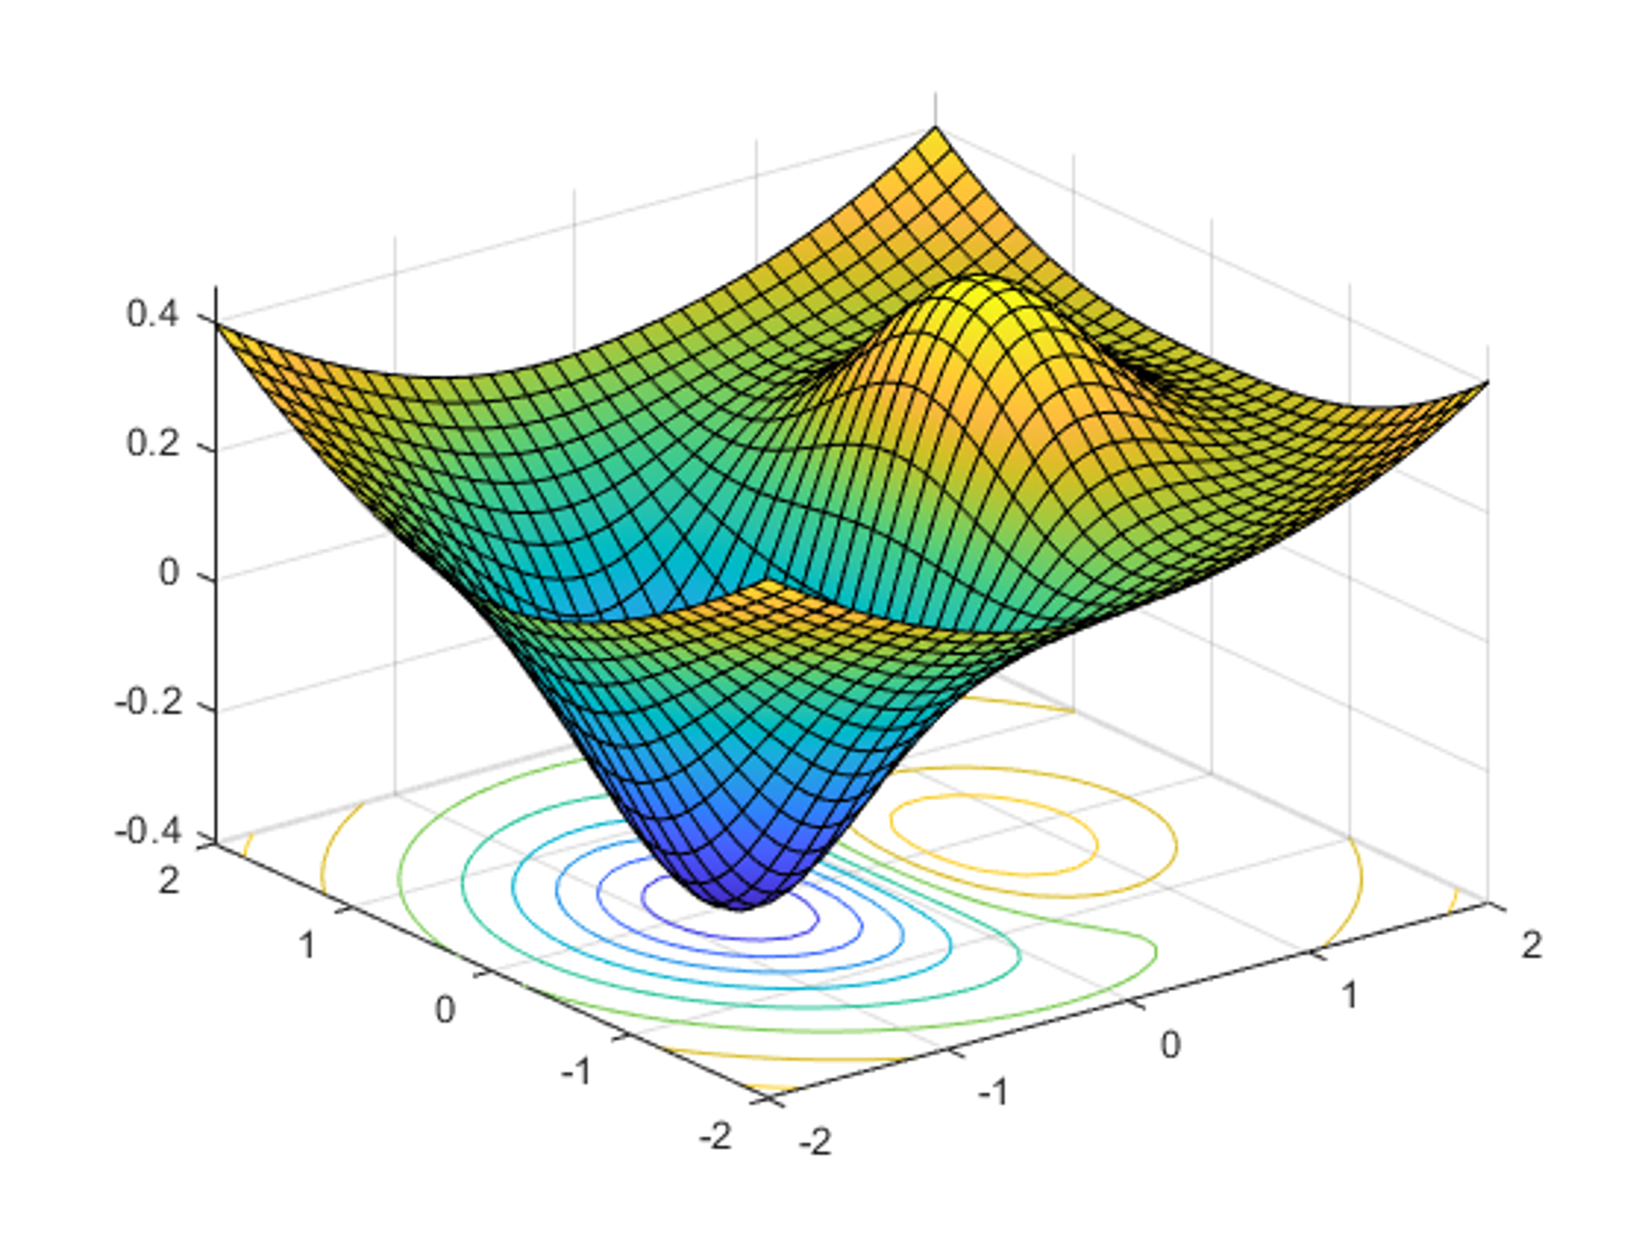

DATA 585 Optimization
Picture generated on MATLAB using
f = @(x,y) x.*exp(-x.^2-y.^2)+(x.^2+y.^2)/20;
fsurf(f,[-2,2],'ShowContours','on’)
Code example from https://www.mathworks.com/help/optim/ug/optimization-toolbox-tutorial.html
Instructor: Yves Lucet
$$\min{\{f\left(x\right):g\left(x\right)≤0;h\left(x\right)=0;x∈S\}}$$
We respectfully acknowledge the Syilx Okanagan Nation and their peoples, in whose traditional, ancestral, unceded territory UBC Okanagan is situated.

Slide 2
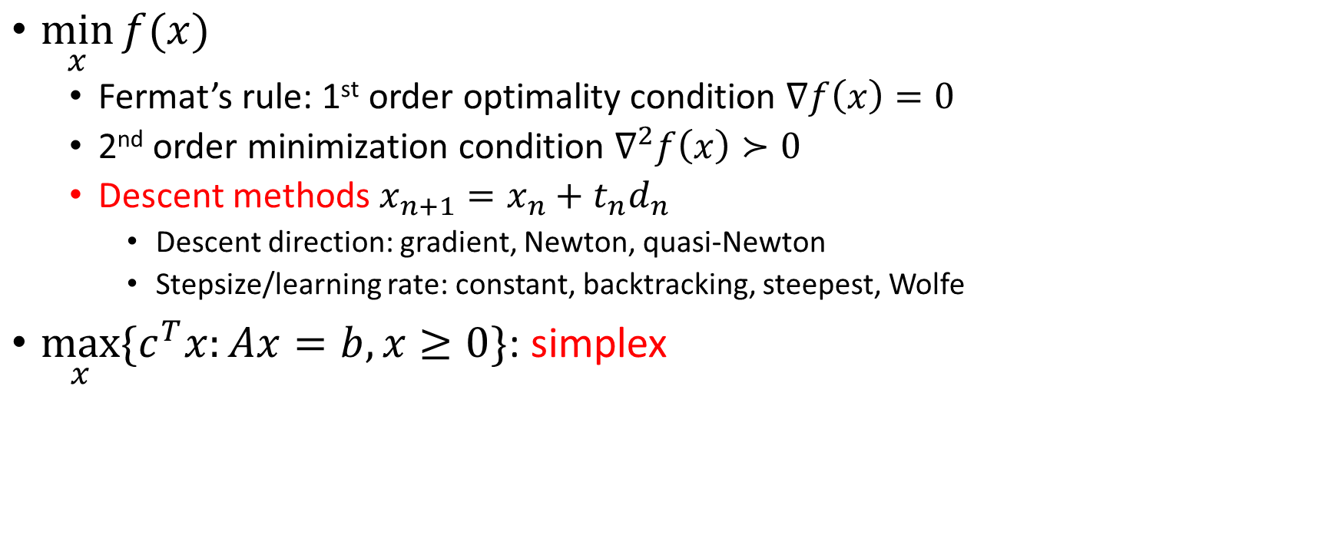
Summary
$\min_{x}{f(x)}$
Fermat’s rule: 1st order optimality condition $∇f\left(x\right)=0$
2nd order minimization condition $∇^{2}f\left(x\right)≻0$
Descent methods $x_{n+1}=x_{n}+t_{n}d_{n}$
Descent direction: gradient, Newton, quasi-Newton
Stepsize/learning rate: constant, backtracking, steepest, Wolfe
$\max_{x}{\{c^{T}x:Ax=b,x≥0\}}$: simplex

Slide 3

Menu
0. plot and deducing primal solution from dual
Mixed Integer Linear Programming (MILP)
Examples
Interior point methods
Integer constraints
Modeling tricks
The 4 possibilities for LP
Image courtesy of Gregory Szarkiewicz / FreeDigitalPhotos.net

Slide 4
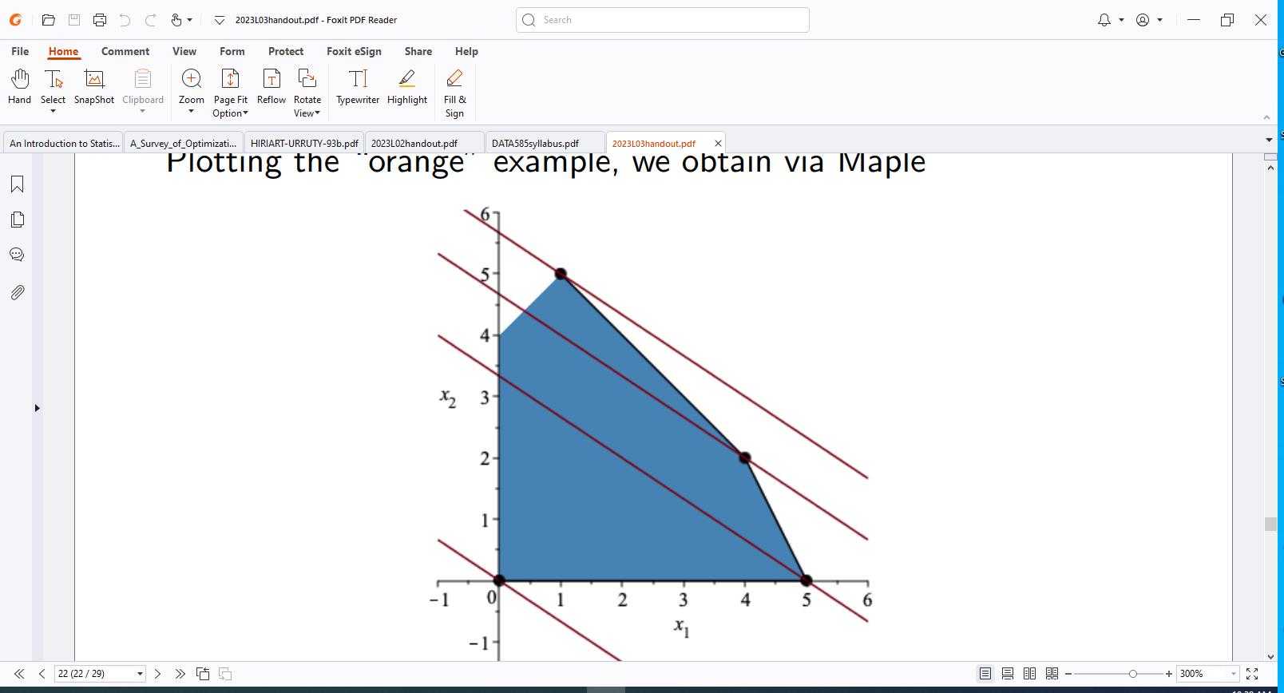

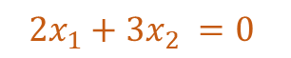
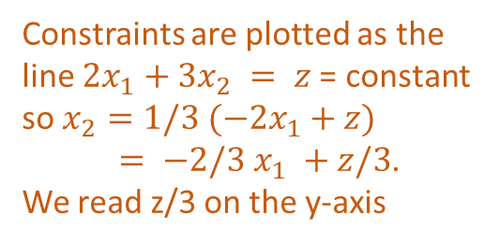
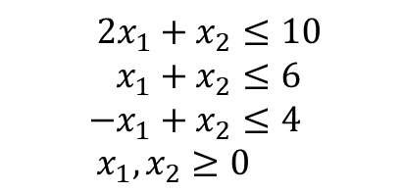
Plot LP with 2 variables
Method 1: pick pivot in order
(0,0) cost 0
(5,0) cost 10
(4,2) cost 14
(1,5) cost 17
$$2x_{1}+3x_{2} =17$$
$$2x_{1}+x_{2}≤10 \\ x_{1}+x_{2}≤6 \\ −x_{1}+x_{2}≤4 \\ x_{1},x_{2}≥0$$
Method 2: pick most negative
(0,0) cost 0
(0,4) cost 12
(1,5) cost 17
$$2x_{1}+3x_{2} =0$$
Constraints are plotted as the line $2x_{1}+3x_{2} = z$= constant so $x_{2}=1/3 (−2x_{1}+z)$ $= −2/3 x_{1} +z/3$. We read z/3 on the y-axis
Feasible region and “profit lines” $z=2x_{1}+3x_{2}$ for $z∈\{0,10,14,17\}$

Slide 5
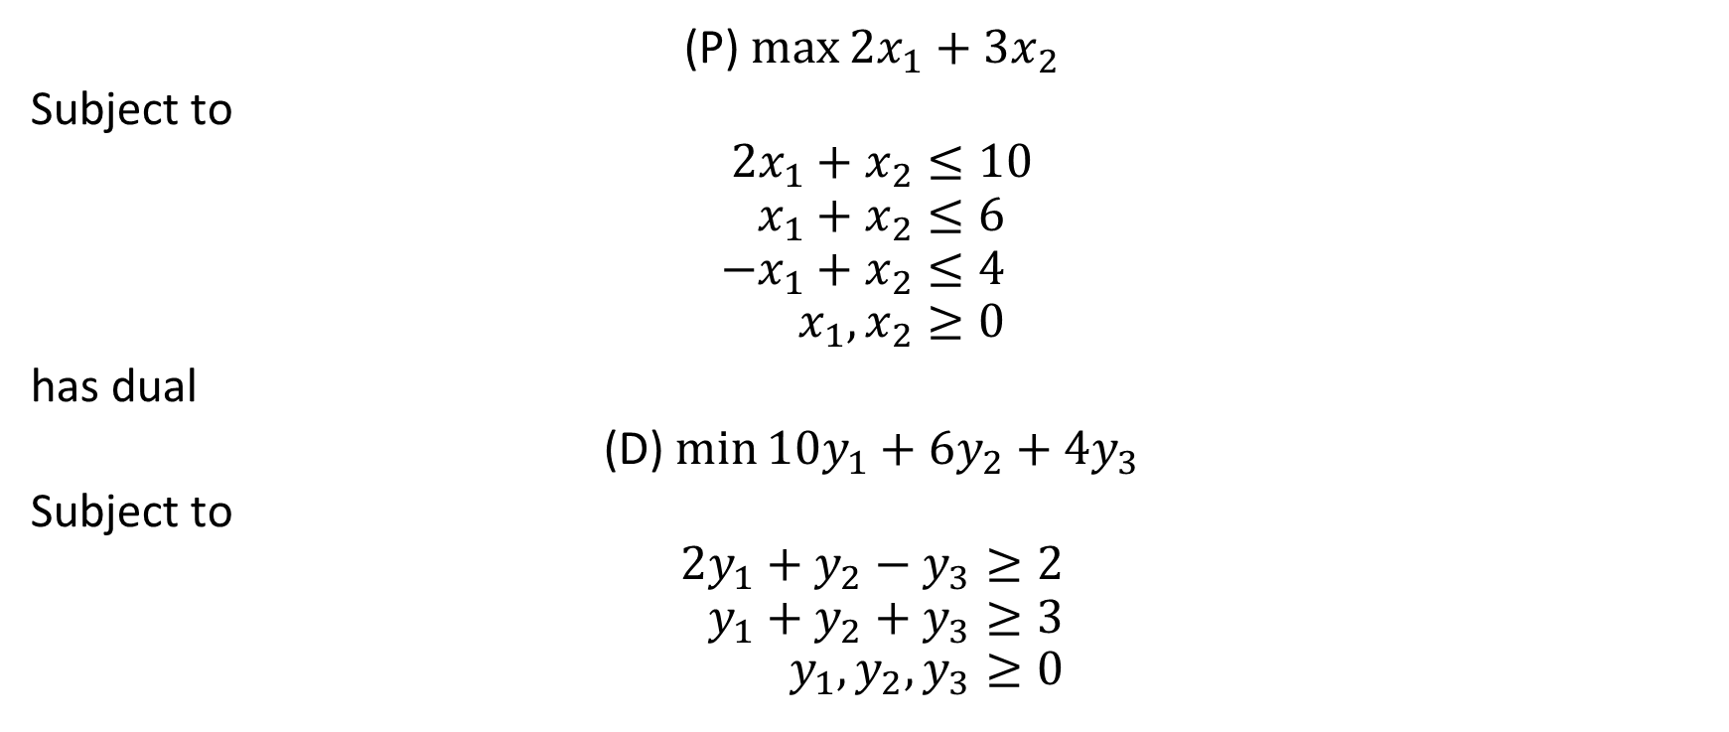
“Orange” primal (P) and dual (D)
(P) $\max{2x_{1}+3x_{2}}$
Subject to
$$2x_{1}+x_{2}≤10 \\ x_{1}+x_{2}≤6 \\ −x_{1}+x_{2}≤4 \\ x_{1},x_{2}≥0$$
has dual
(D) $\min{10y_{1}+6y_{2}+4y_{3}}$
Subject to
$$2y_{1}+y_{2}−y_{3}≥2 \\ y_{1}+y_{2}+y_{3}≥3 \\ y_{1},y_{2},y_{3}≥0$$

Slide 6
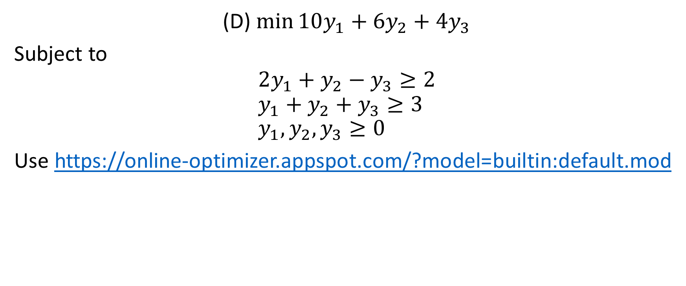
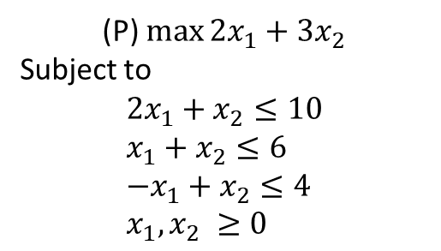
Solve the dual
(P) $\max{2x_{1}+3x_{2}}$
Subject to
$$2x_{1}+x_{2}≤10 \\ x_{1}+x_{2}≤6 \\ −x_{1}+x_{2}≤4 \\ x_{1},x_{2} ≥0$$
(D) $\min{10y_{1}+6y_{2}+4y_{3}}$
Subject to
$$2y_{1}+y_{2}−y_{3}≥2 \\ y_{1}+y_{2}+y_{3}≥3 \\ y_{1},y_{2},y_{3}≥0$$
Use https://online-optimizer.appspot.com/?model=builtin:default.mod

Slide 7
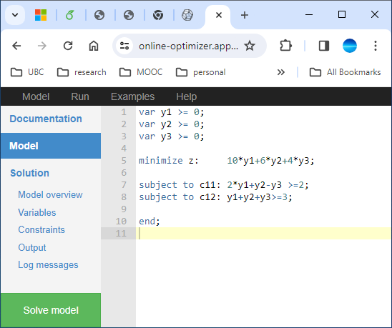
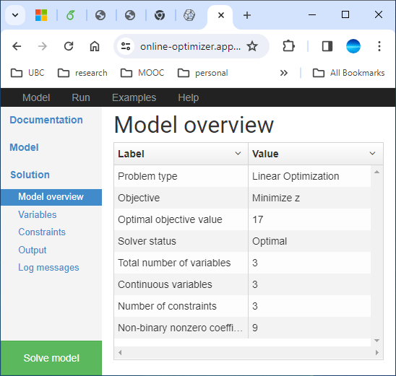
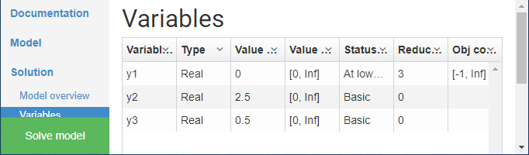

Slide 8
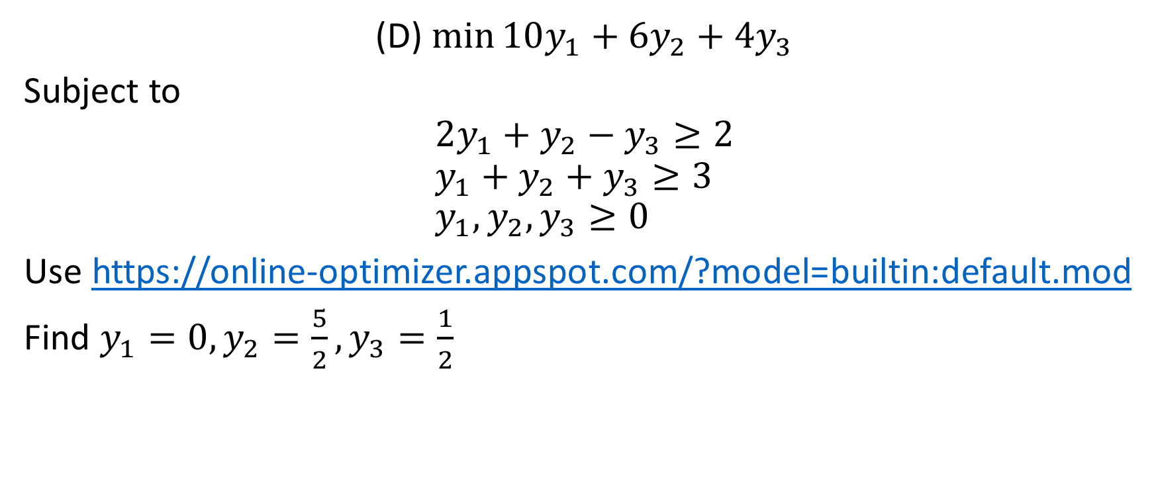
Solve the dual
(P) $\max{2x_{1}+3x_{2}}$
Subject to
$$2x_{1}+x_{2}≤10 \\ x_{1}+x_{2}≤6 \\ −x_{1}+x_{2}≤4 \\ x_{1},x_{2} ≥0$$
(D) $\min{10y_{1}+6y_{2}+4y_{3}}$
Subject to
$$2y_{1}+y_{2}−y_{3}≥2 \\ y_{1}+y_{2}+y_{3}≥3 \\ y_{1},y_{2},y_{3}≥0$$
Use https://online-optimizer.appspot.com/?model=builtin:default.mod
Find $y_{1}=0, y_{2}=\frac{5}{2},y_{3}=\frac{1}{2}$

Slide 9
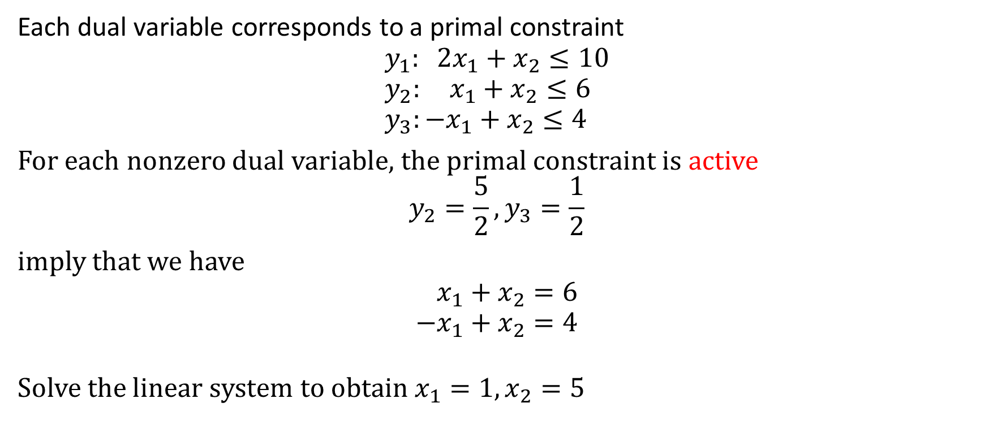
Deduce the primal solution
(P) $\max{2x_{1}+3x_{2}}$
Subject to
$$2x_{1}+x_{2}≤10 \\ x_{1}+x_{2}≤6 \\ −x_{1}+x_{2}≤4 \\ x_{1},x_{2} ≥0$$
Each dual variable corresponds to a primal constraint
$$y_{1}: 2x_{1}+x_{2}≤10 \\ y_{2}: x_{1}+x_{2}≤6 \\ y_{3}:−x_{1}+x_{2}≤4$$ For each nonzero dual variable, the primal constraint is active
$$y_{2}=\frac{5}{2},y_{3}=\frac{1}{2}$$ imply that we have
$$x_{1}+x_{2}=6 \\ −x_{1}+x_{2}=4$$
Solve the linear system to obtain $x_{1}=1, x_{2}=5$
Notes:
An active inequality constraints means that it holds as an equality

Slide 10
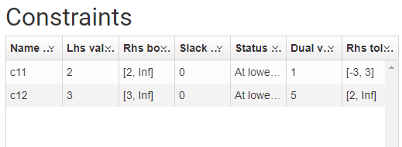

Slide 11
More examples

Slide 12
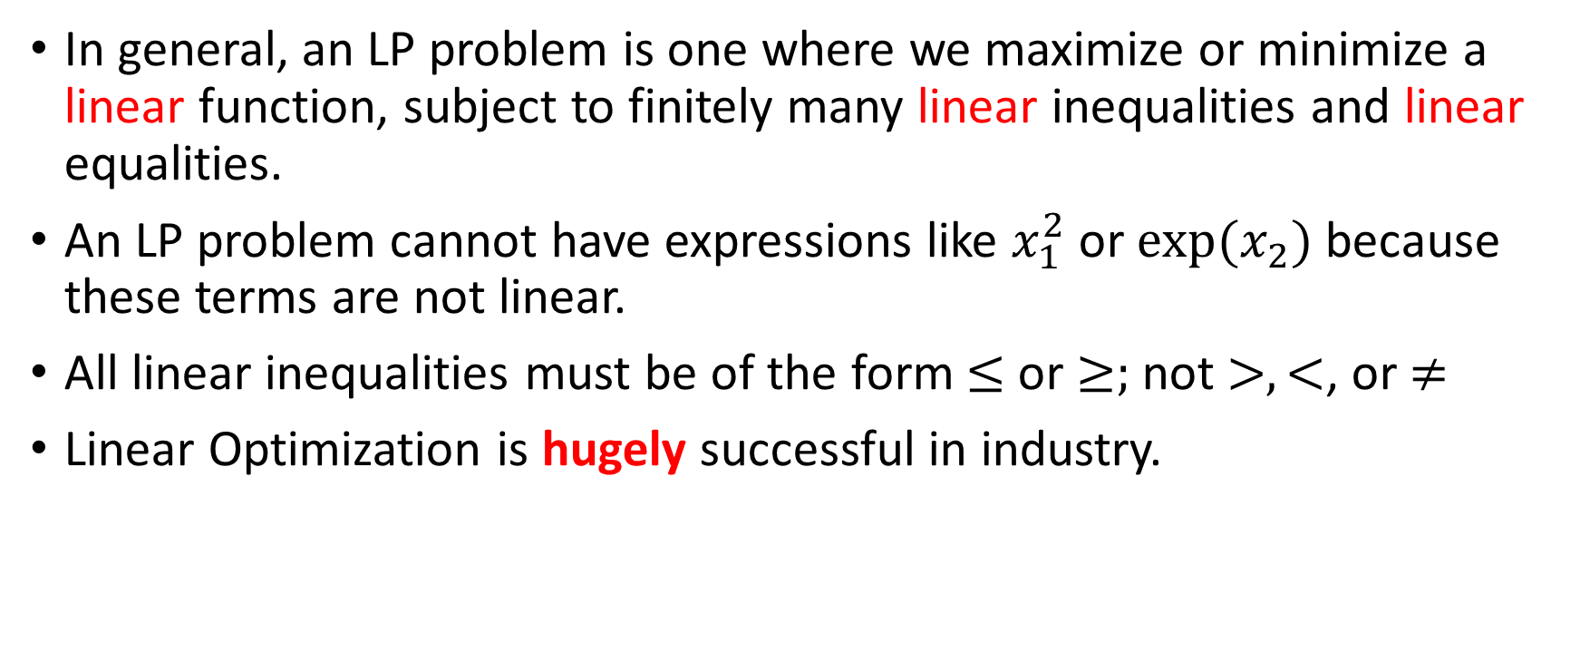
General comments
In general, an LP problem is one where we maximize or minimize a linear function, subject to finitely many linear inequalities and linear equalities.
An LP problem cannot have expressions like $x_{1}^{2}$ or $exp⁡(x_{2})$because these terms are not linear.
All linear inequalities must be of the form $≤$ or $≥;$ not $>, <$, or $≠$
Linear Optimization is hugely successful in industry.

Slide 13
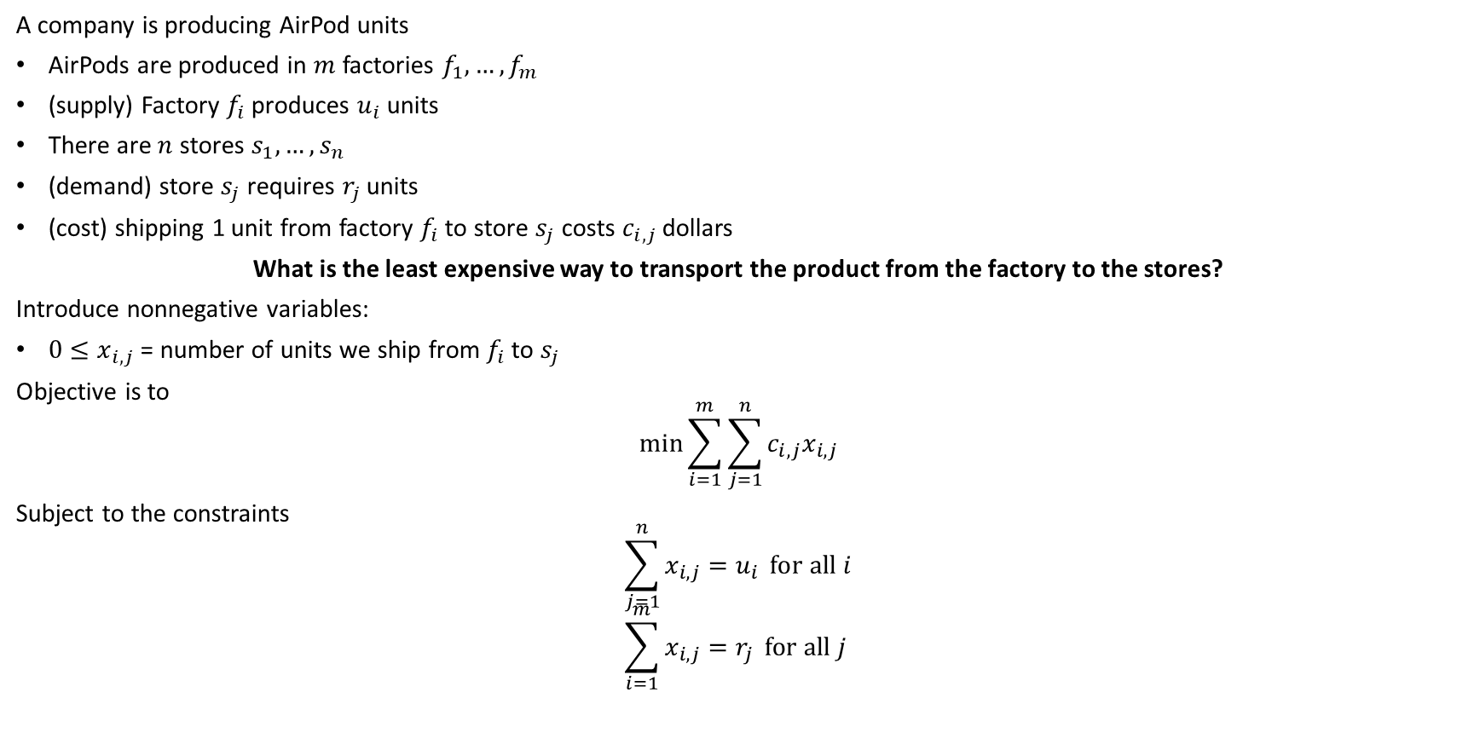
Transportation problem
A company is producing AirPod units
AirPods are produced in $m$ factories $f_{1},…, f_{m}$
(supply) Factory $f_{i}$ produces $u_{i}$ units
There are $n$ stores $s_{1},…, s_{n}$
(demand) store $s_{j}$ requires $r_{j}$ units
(cost) shipping 1 unit from factory $f_{i}$ to store $s_{j}$ costs $c_{i,j}$ dollars
What is the least expensive way to transport the product from the factory to the stores?
Introduce nonnegative variables:
$0≤x_{i,j}$ = number of units we ship from $f_{i}$ to $s_{j}$
Objective is to
$$\min{\sum_{i=1}^{m}{\sum_{j=1}^{n}{c_{i,j}x_{i,j}}}}$$
Subject to the constraints
$$\sum_{j=1}^{n}{x_{i,j}=u_{i} }for all i \\ \sum_{i=1}^{m}{x_{i,j}=r_{j}} for all j$$

Slide 14
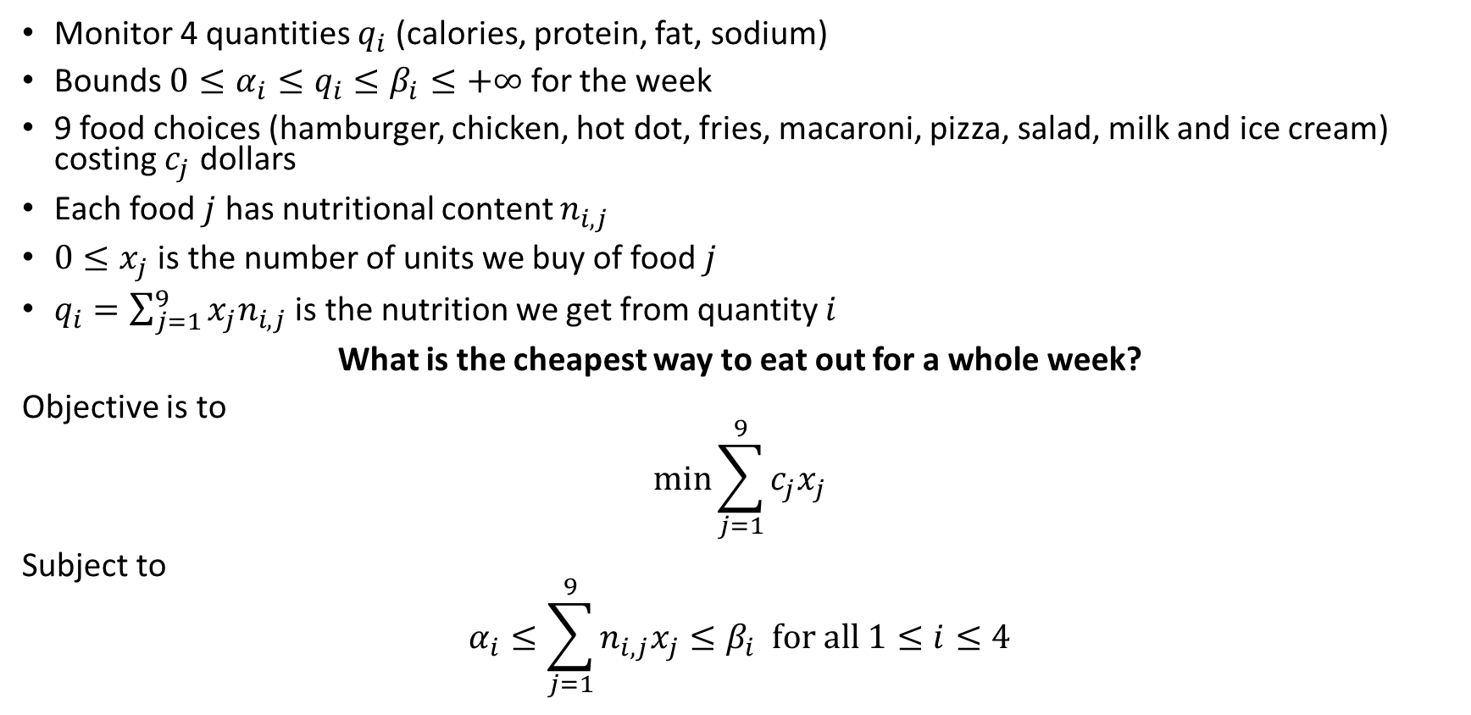
The diet problem
Monitor 4 quantities $q_{i}$ (calories, protein, fat, sodium)
Bounds $0≤α_{i}≤q_{i}≤β_{i}≤+∞$ for the week
9 food choices (hamburger, chicken, hot dot, fries, macaroni, pizza, salad, milk and ice cream) costing $c_{j}$ dollars
Each food $j$ has nutritional content $n_{i,j}$
$0≤x_{j}$ is the number of units we buy of food $j$
$q_{i}=\sum_{j=1}^{9}{x_{j}n_{i,j}}$ is the nutrition we get from quantity $i$
What is the cheapest way to eat out for a whole week?
Objective is to
$$\min{\sum_{j=1}^{9}{c_{j}x_{j}}}$$
Subject to
$$α_{i}≤\sum_{j=1}^{9}{n_{i,j}x_{j}}≤β_{i} for all 1≤i≤4$$

Slide 15
Interior Point Methods

Slide 16
History: linear programming
prior to 1984: no connection between linear and nonlinear programming
linear programming
simplex method Dantzig 1947: move from vertex to vertex; incorporated linear algebra techniques in the 1960s
nonsimplex strategies suggested in 1950s till early 1980s but never approached simplex speed and reliability
simplex has exponential worst-case complexity: disconnect between observed and theoretical efficiency
1979 Khachian ellipsoid method polynomial time; comes from nonlinear programming; slow in practice. Unsatisfactory!

Slide 17
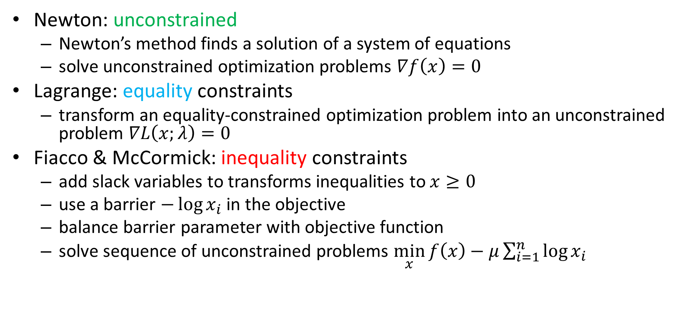
Key Ideas: Interior Point Method for Linear Programming
Newton: unconstrained
Newton’s method finds a solution of a system of equations
solve unconstrained optimization problems $∇f\left(x\right)=0$
Lagrange: equality constraints
transform an equality-constrained optimization problem into an unconstrained problem $∇L\left(x;λ\right)=0$
Fiacco & McCormick: inequality constraints
add slack variables to transforms inequalities to $x≥0$
use a barrier $−\log{x_{i}}$ in the objective
balance barrier parameter with objective function
solve sequence of unconstrained problems $\min_{x}{f\left(x\right)−μ\sum_{i=1}^{n}{\log{x_{i}}}}$

Slide 18
History: nonlinear programming
Newton’s method
line-search
trust-region
barrier methods for constrained optimization
1960s golden age of unconstrained optimization: convert constraint problems to (sequence of) unconstrained: penalty and barrier methods
barrier methods widely used in the 1960s but declined in 1970s due to perceived inefficiency
Augmented Lagrangian methods and sequential quadratic programming methods became popular

Slide 19
The revolution
Karmarkar’s method in 1984: polynomial-time LP method reportedly 50 times faster than simplex. Beginning of interior-point revolution
1985: formal equivalence between Karmarkar’s method and classical logarithmic barrier method applied to LP
change in thinking: today linear and nonlinear programming are viewed from unified perspective
progress: central paths play critical role in complexity analyses
Nesterov and Nemirovskii work in late 1980s extended polynomial-time complexity to wide family of convex optimization problems. Allowed defining new barriers, e.g. for semidefinite programming.
interior-point methods require number of iterations much smaller than their upper-bound; still work to be done to understand their efficiency
ill-conditioning issues much better understood
primal-dual interior point methods for LP enormously successful in practice.
revolution result: today IP methods faster than simplex on some very large problems but reverse true for other problems; two approaches comparable on others
Commercial LP routinely offer both simplex and interior point methods
primal-dual methods popular for nonlinear programming

Slide 20
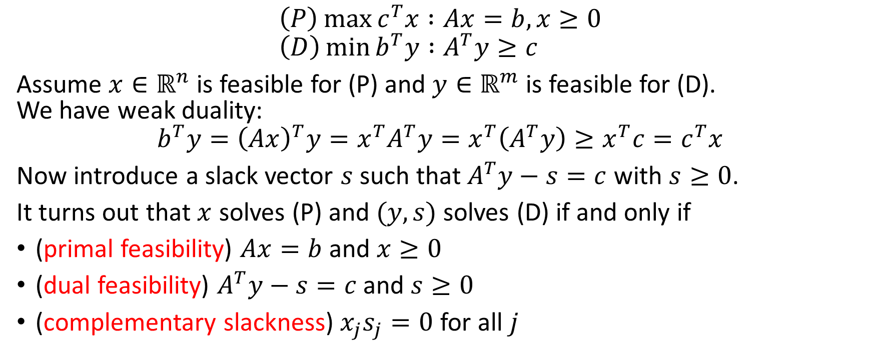
Weak duality revisited
$$\left(P\right)\max{c^{T}x :Ax=b, x≥0} \\ \left(D\right)\min{b^{T}y :A^{T}y≥c}$$
Assume $x∈ℝ^{n}$ is feasible for (P) and $y∈ℝ^{m}$ is feasible for (D). We have weak duality:
$$b^{T}y={\left(Ax\right)}^{T}y=x^{T}A^{T}y=x^{T}\left(A^{T}y\right)≥x^{T}c=c^{T}x$$
Now introduce a slack vector $s$ such that $A^{T}y−s=c$ with $s≥0$.
It turns out that $x$ solves (P) and $(y,s)$ solves (D) if and only if
(primal feasibility) $Ax=b$ and $x≥0$
(dual feasibility) $A^{T}y−s=c$ and $s≥0$
(complementary slackness) $x_{j}s_{j}=0$ for all $j$

Slide 21
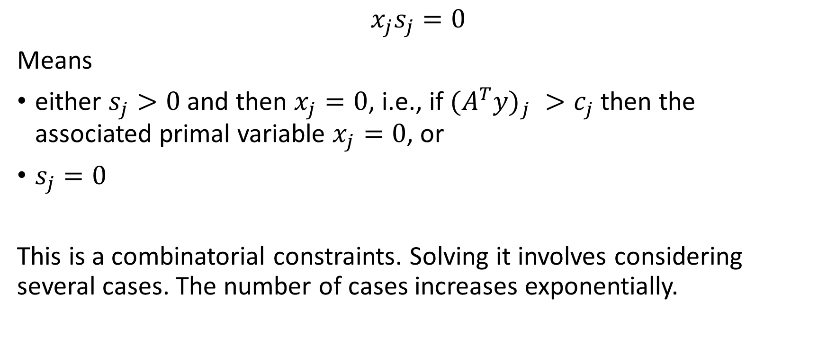
Complementarity
$$x_{j}s_{j}=0$$
Means
either $s_{j}>0$ and then $x_{j}=0$, i.e., if ${{(A}^{T}y)}_{j} >c_{j}$ then the associated primal variable $x_{j}=0$, or
$s_{j}=0$
This is a combinatorial constraints. Solving it involves considering several cases. The number of cases increases exponentially.

Slide 22
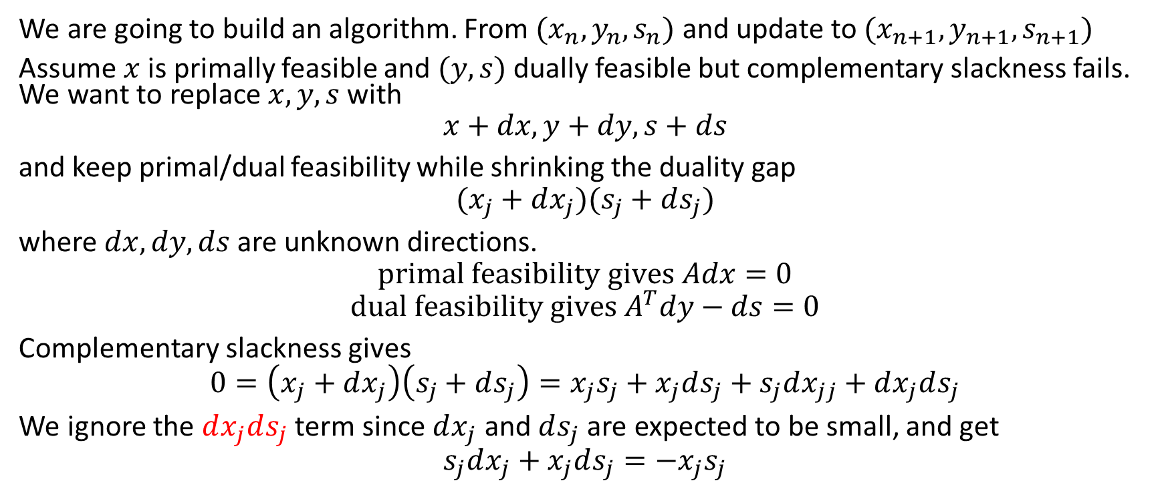

Finding new updates for $x, y, s$
We are going to build an algorithm. From ${(x}_{n},y_{n},s_{n})$ and update to $(x_{n+1},y_{n+1},s_{n+1})$
Assume $x$ is primally feasible and $(y,s)$ dually feasible but complementary slackness fails. We want to replace $x, y, s$ with
$$x+dx, y+dy, s+ds$$
and keep primal/dual feasibility while shrinking the duality gap
$$(x_{j}+dx_{j})(s_{j}+ds_{j})$$
where $dx, dy, ds$ are unknown directions.
$$primal feasibility gives Adx=0$$
$$dual feasibility gives A^{T}dy−ds=0$$
Complementary slackness gives
$$0=\left(x_{j}+dx_{j}\right)\left(s_{j}+ds_{j}\right)=x_{j}s_{j}+x_{j}ds_{j}+s_{j}dx_{jj}+dx_{j}ds_{j}$$
We ignore the $dx_{j}ds_{j}$ term since $dx_{j}$ and $ds_{j}$ are expected to be small, and get
$$s_{j}dx_{j}+x_{j}ds_{j}=−x_{j}s_{j}$$

Slide 23
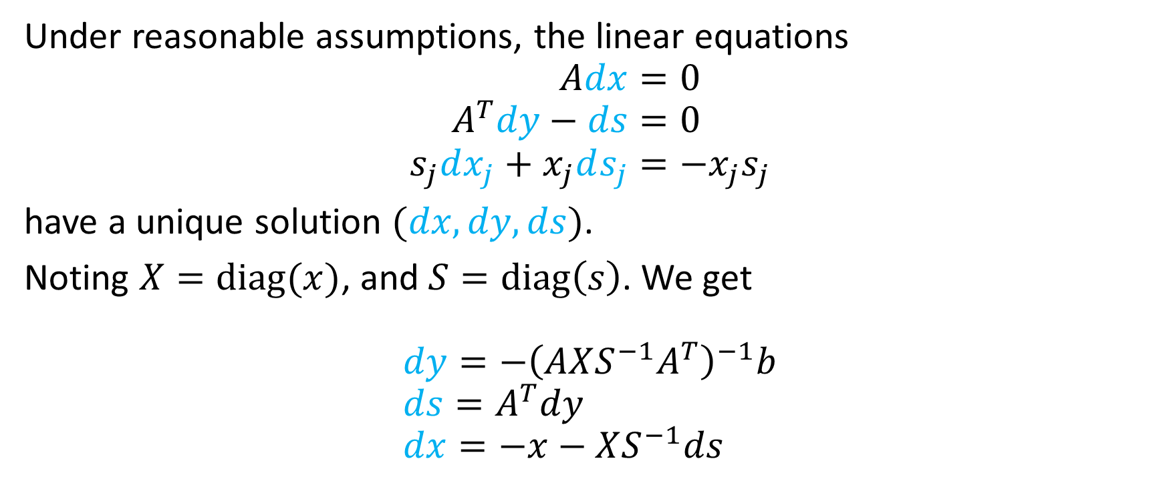
Finding new updates for $x, y, s$
Under reasonable assumptions, the linear equations
$$Adx=0 \\ A^{T}dy−ds=0 \\ s_{j}dx_{j}+x_{j}ds_{j}=−x_{j}s_{j}$$
have a unique solution $(dx, dy, ds)$.
Noting $X=diag(x)$, and $S=diag\left(s\right)$. We get
$$dy=−{\left(AXS^{−1}A^{T}\right)}^{−1}b \\ ds=A^{T}dy \\ dx=−x−XS^{−1}ds$$
Notes:
Variables computed as solution to the linear system are in blue
X=diag(x) means X is a diagonal matrix with $x$ on the diagonal

Slide 24
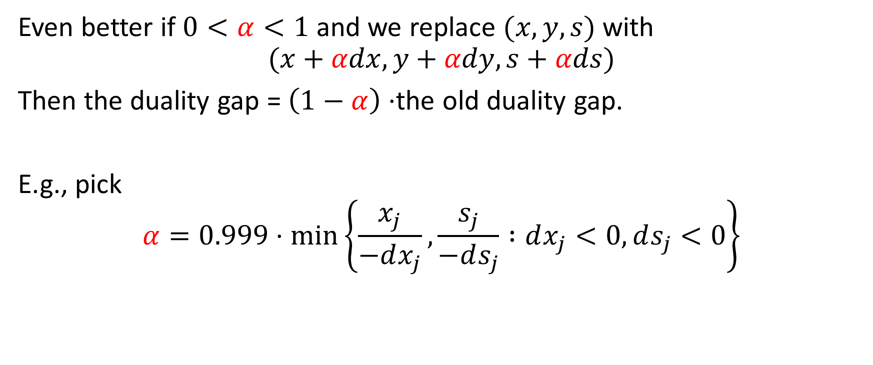
Finding new updates for $x, y, s$
Even better if $0<α<1$ and we replace $(x,y,s)$ with
$$(x+αdx,y+αdy,s+αds)$$
Then the duality gap = $\left(1−α\right)⋅$the old duality gap.
E.g., pick
$$α=0.999⋅\min\left\{\frac{x_{j}}{−dx_{j}},\frac{s_{j}}{−ds_{j}} :dx_{j}<0, ds_{j}<0\right\}$$

Slide 25
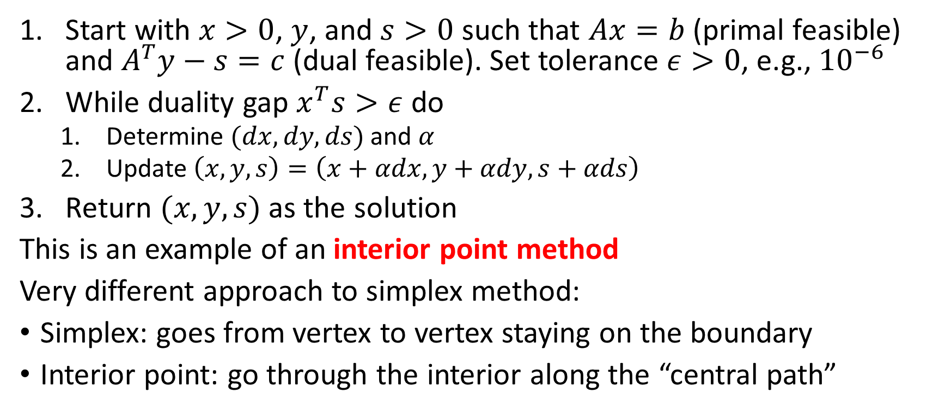
Primal-dual affine scaling
Start with $x>0$, $y$, and $s>0$ such that $Ax=b$ (primal feasible) and $A^{T}y−s=c$ (dual feasible). Set tolerance $ε>0$, e.g., ${10}^{−6}$
While duality gap $x^{T}s>ε$ do
Determine $(dx,dy,ds)$ and $α$
Update $\left(x,y,s\right)=\left(x+αdx,y+αdy,s+αds\right)$
Return $(x,y,s)$ as the solution
This is an example of an interior point method
Very different approach to simplex method:
Simplex: goes from vertex to vertex staying on the boundary
Interior point: go through the interior along the “central path”
Solve a linear system

Slide 26
Simplex vs. Interior point
Both are very good at solving problems
Theoretically
Interior point methods
run in polynomial time
Small number of expensive iterations
Worst-case of simplex
runs in exponential time
Large number of cheap iterations
Practically, it depends on the structure of the problem
Small to medium scale: both work well
Large scale
interior point work well if they can keep the matrices sparse
Simplex works well if warm starting is leveraged

Slide 27
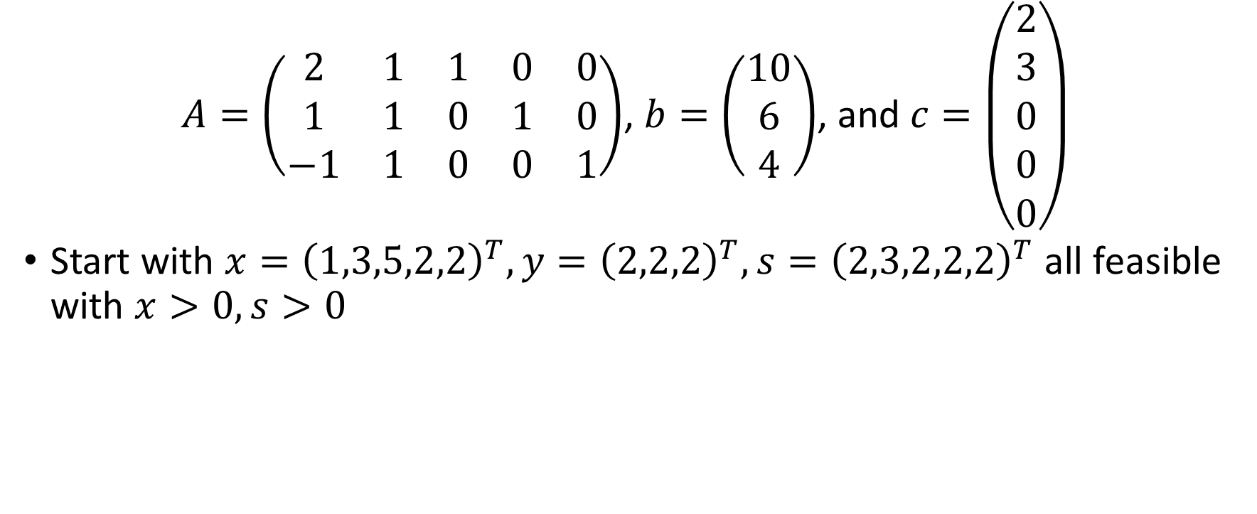
“orange” example
$A=\left(\begin{matrix}2 & 1 & 1 & 0 & 0 \\ 1 & 1 & 0 & 1 & 0 \\ −1 & 1 & 0 & 0 & 1\end{matrix}\right)$, $b=\left(\begin{matrix}10 \\ 6 \\ 4\end{matrix}\right)$, and $c=\left(\begin{matrix}2 \\ 3 \\ 0 \\ 0 \\ 0\end{matrix}\right)$
Start with $x={\left(1,3,5,2,2\right)}^{T}, y={\left(2,2,2\right)}^{T}, s={\left(2,3,2,2,2\right)}^{T}$ all feasible with $x>0, s>0$

Slide 28
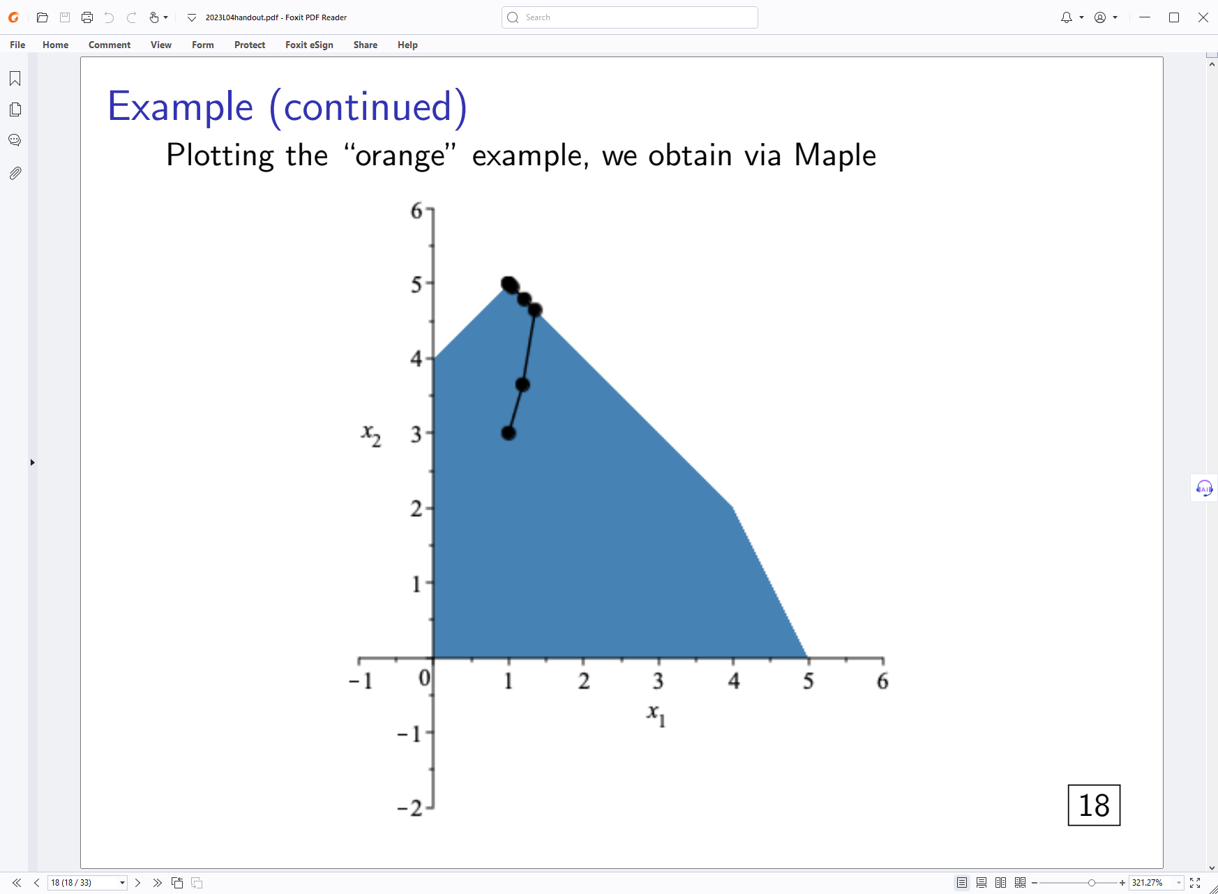
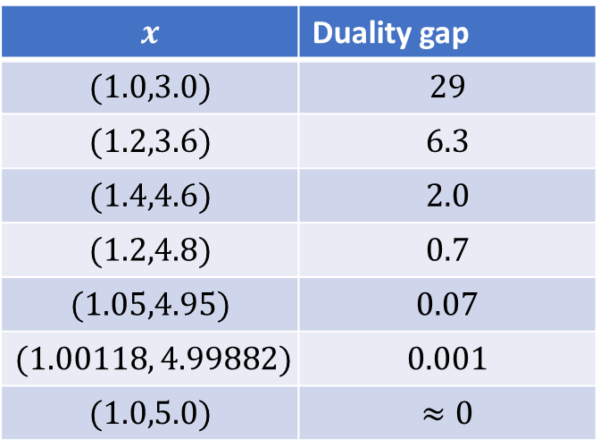
“orange” example
Running the algorithm gives
$$x$$ | Duality gap
$$(1.0,3.0)$$ | $$29$$
$$(1.2,3.6)$$ | $$6.3$$
$$(1.4,4.6)$$ | $$2.0$$
$$(1.2,4.8)$$ | $$0.7$$
$$(1.05,4.95)$$ | $$0.07$$
$$(1.00118, 4.99882)$$ | $$0.001$$
$$(1.0,5.0)$$ | $$≈0$$

Slide 29
Integer constraints

Slide 30
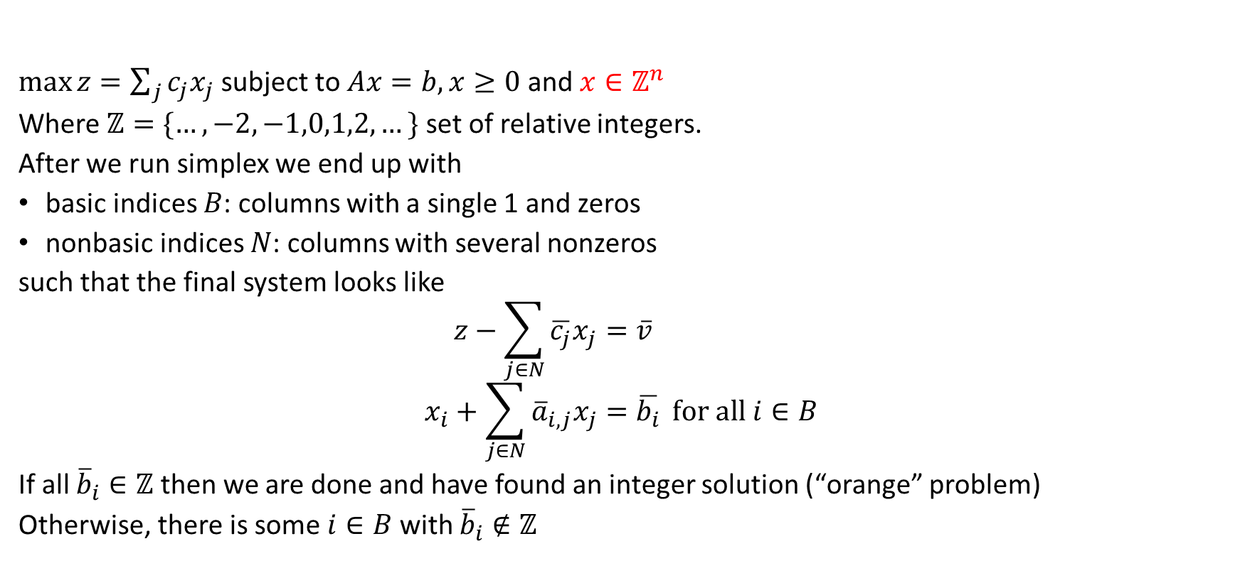
Integer constraints
$\max{z=\sum_{j}{c_{j}x_{j}}}$ subject to $Ax=b, x≥0$ and $x∈ℤ^{n}$
Where $ℤ=\{…,−2,−1,0,1,2,…\}$ set of relative integers.
After we run simplex we end up with
basic indices $B$: columns with a single 1 and zeros
nonbasic indices $N$: columns with several nonzeros
such that the final system looks like
$$z−\sum_{j∈N}{\overline{c_{j}}x_{j}=\overline{v}} \\ x_{i}+\sum_{j∈N}{{\overline{a}}_{i,j}x_{j}=\overline{b_{i}}} for all i∈B$$
If all ${\overline{b}}_{i}∈ℤ$ then we are done and have found an integer solution (“orange” problem)
Otherwise, there is some $i∈B$ with ${\overline{b}}_{i}∉ℤ$
Notes:
Non-basic variables are variables that are set to zero (several nonzero values in that column)
Basic variables have a column with a single 1 and several zeros

Slide 31
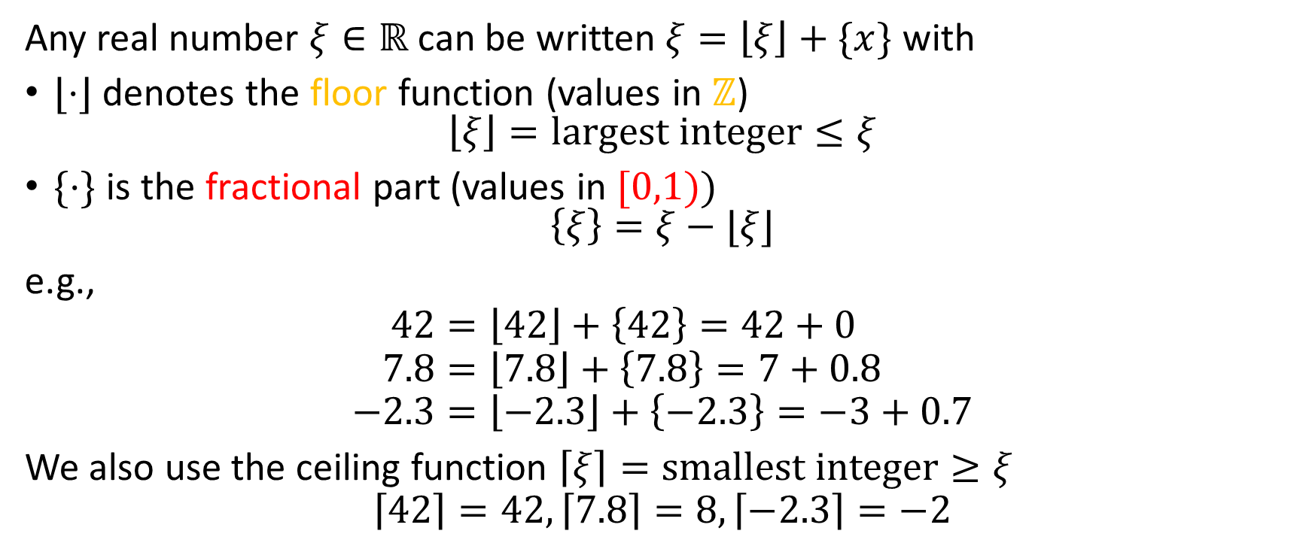
Integer constraints
Any real number $ξ∈ℝ$ can be written $ξ=\left\lfloor ξ\right\rfloor +\{x\}$ with
$⌊⋅⌋$ denotes the floor function (values in $ℤ$) $\left\lfloor ξ\right\rfloor =largest integer≤ξ$
$\{⋅\}$ is the fractional part (values in $[0,1))$ $\left\{ξ\right\}=ξ−⌊ξ⌋$
e.g.,
$$42=\left\lfloor 42\right\rfloor +\left\{42\right\}=42+0 \\ 7.8=\left\lfloor 7.8\right\rfloor +\left\{7.8\right\}=7+0.8 \\ −2.3=\left\lfloor −2.3\right\rfloor +\left\{−2.3\right\}=−3+0.7$$
We also use the ceiling function $\left\lceil ξ\right\rceil =smallest integer≥ξ$
$$\left\lceil 42\right\rceil =42, \left\lceil 7.8\right\rceil =8, \left\lceil −2.3\right\rceil =−2$$

Slide 32
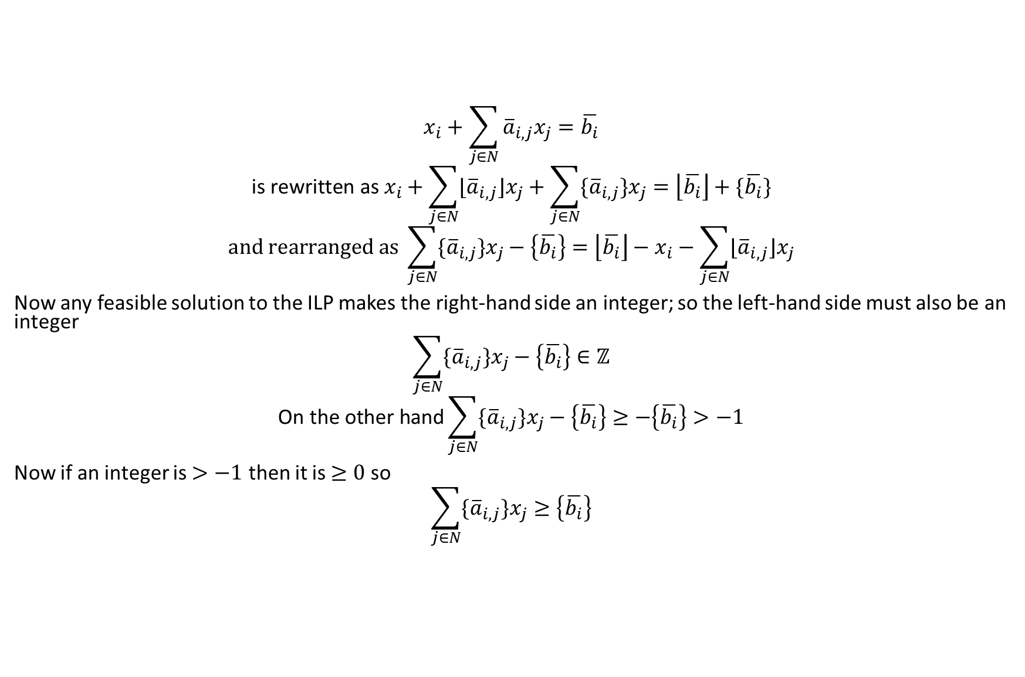
A simple yet powerful observation!
$$x_{i}+\sum_{j∈N}{{\overline{a}}_{i,j}x_{j}=\overline{b_{i}}}$$
$${\text{is} \text{rewritten} \text{as} x}_{i}+\sum_{j∈N}{{⌊\overline{a}}_{i,j}⌋x_{j}+\sum_{j∈N}{{\{\overline{a}}_{i,j}\}x_{j}}}=\left\lfloor \overline{b_{i}}\right\rfloor +\{\overline{b_{i}}\}$$
$$and rearranged as \sum_{j∈N}{{\{\overline{a}}_{i,j}\}x_{j}}−\left\{\overline{b_{i}}\right\}=\left\lfloor \overline{b_{i}}\right\rfloor −x_{i}−\sum_{j∈N}{{⌊\overline{a}}_{i,j}⌋x_{j}}$$
Now any feasible solution to the ILP makes the right-hand side an integer; so the left-hand side must also be an integer
$$\sum_{j∈N}{{\{\overline{a}}_{i,j}\}x_{j}}−\left\{\overline{b_{i}}\right\}∈ℤ$$
$$\text{On} \text{the} \text{other} \text{hand}\sum_{j∈N}{{\{\overline{a}}_{i,j}\}x_{j}}−\left\{\overline{b_{i}}\right\}≥−\left\{\overline{b_{i}}\right\}>−1$$
Now if an integer is $>−1$ then it is $≥0$ so
$$\sum_{j∈N}{{\{\overline{a}}_{i,j}\}x_{j}}≥\left\{\overline{b_{i}}\right\}$$

Slide 33
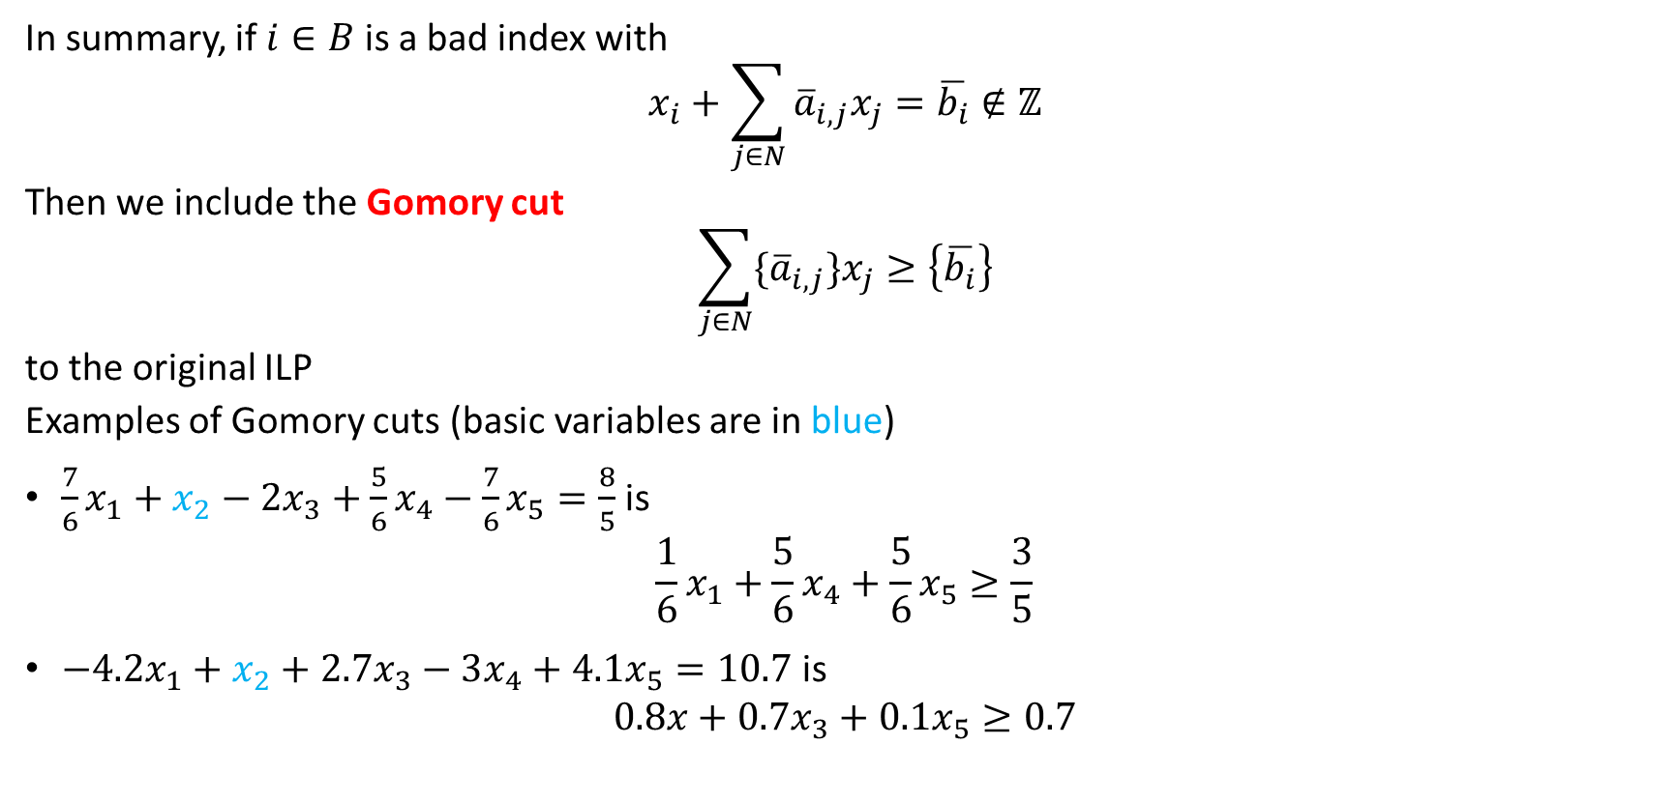
The Gomory cut
In summary, if $i∈B$ is a bad index with
$$x_{i}+\sum_{j∈N}{{\overline{a}}_{i,j}x_{j}=\overline{b_{i}}}∉ℤ$$
Then we include the Gomory cut
$$\sum_{j∈N}{{\{\overline{a}}_{i,j}\}x_{j}}≥\left\{\overline{b_{i}}\right\}$$
to the original ILP
Examples of Gomory cuts (basic variables are in blue)
$\frac{7}{6}x_{1}+x_{2}−2x_{3}+\frac{5}{6}x_{4}−\frac{7}{6}x_{5}=\frac{8}{5}$ is $\frac{1}{6}x_{1}+\frac{5}{6}x_{4}+\frac{5}{6}x_{5}≥\frac{3}{5}$
$−4.2x_{1}+x_{2}+2.7x_{3}−3x_{4}+4.1x_{5}=10.7$ is $0.8x+0.7x_{3}+0.1x_{5}≥0.7$

Slide 34
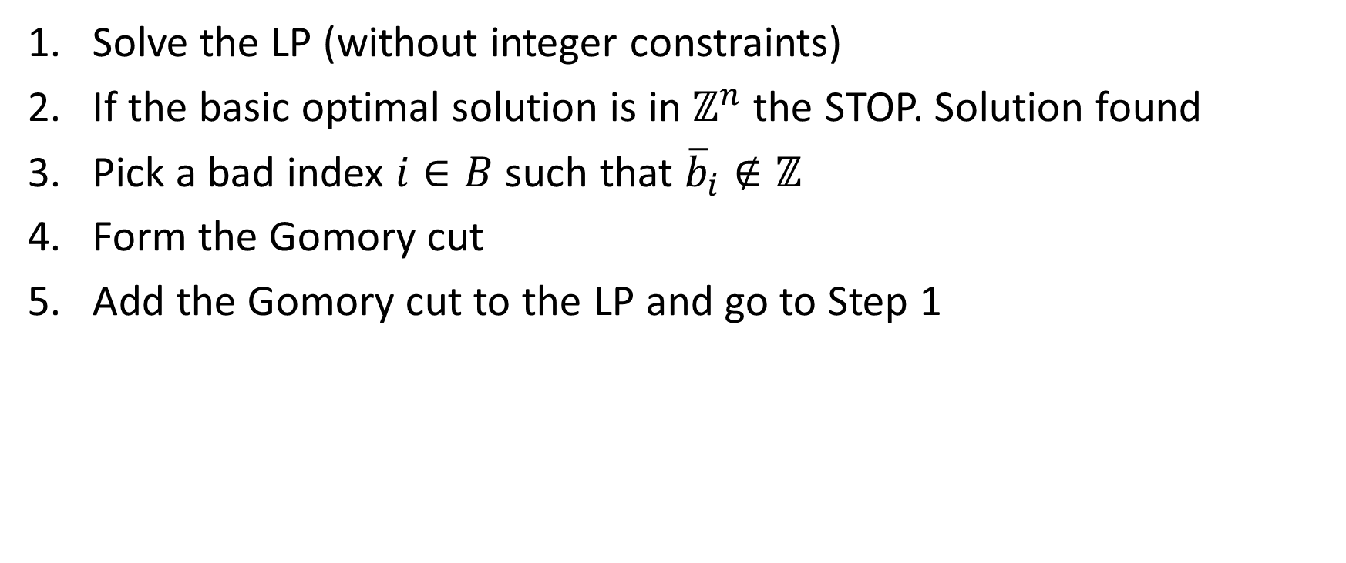
Cutting plane algorithms
Solve the LP (without integer constraints)
If the basic optimal solution is in $ℤ^{n}$ the STOP. Solution found
Pick a bad index $i∈B$ such that ${\overline{b}}_{i}∉ℤ$
Form the Gomory cut
Add the Gomory cut to the LP and go to Step 1

Slide 35
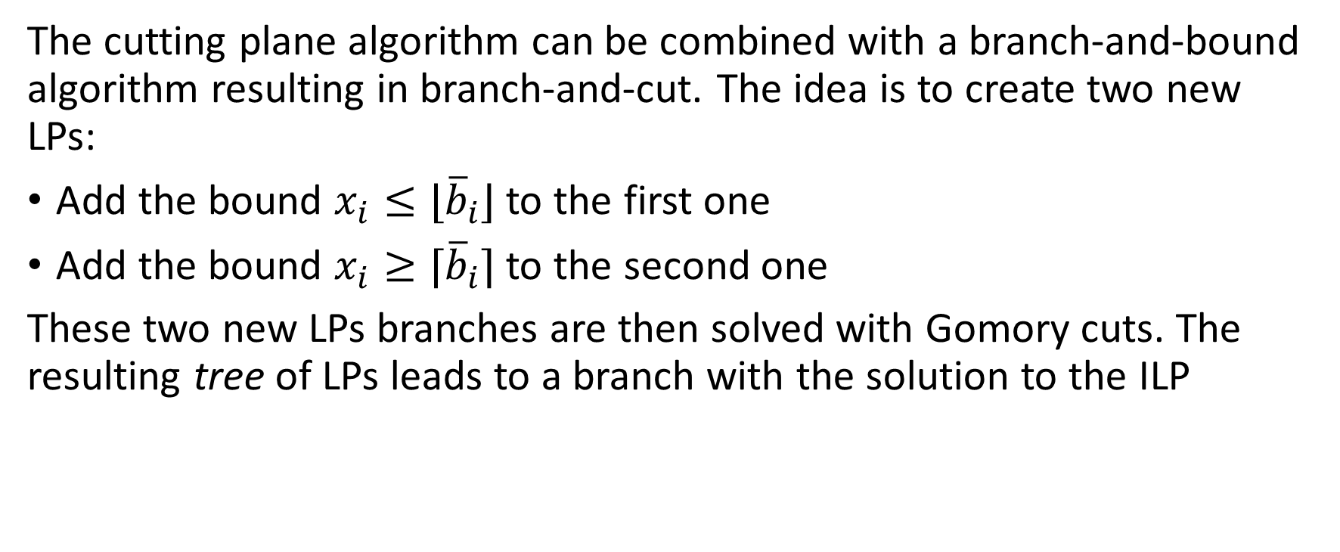
Branch-and-cut algorithms
The cutting plane algorithm can be combined with a branch-and-bound algorithm resulting in branch-and-cut. The idea is to create two new LPs:
Add the bound $x_{i}≤⌊{\overline{b}}_{i}⌋$ to the first one
Add the bound $x_{i}≥⌈{\overline{b}}_{i}⌉$ to the second one
These two new LPs branches are then solved with Gomory cuts. The resulting tree of LPs leads to a branch with the solution to the ILP

Slide 36
Modeling tricks

Slide 37
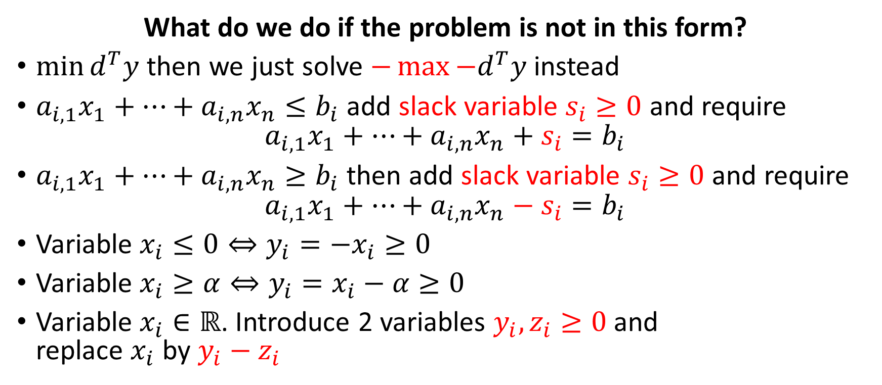

$$\max{z=c^{T}x subject to Ax=b, x≥0}$$
What do we do if the problem is not in this form?
$\min{d^{T}y}$ then we just solve $−\max{−d^{T}y}$ instead
$a_{i,1}x_{1}+⋯+a_{i,n}x_{n}≤b_{i}$ add slack variable $s_{i}≥0$ and require $a_{i,1}x_{1}+⋯+a_{i,n}x_{n}+s_{i}=b_{i}$
$a_{i,1}x_{1}+⋯+a_{i,n}x_{n}≥b_{i}$ then add slack variable $s_{i}≥0$ and require $a_{i,1}x_{1}+⋯+a_{i,n}x_{n}−s_{i}=b_{i}$
Variable $x_{i}≤0⇔y_{i}=−x_{i}≥0$
Variable $x_{i}≥α⇔y_{i}=x_{i}−α≥0$
Variable $x_{i}∈ℝ$. Introduce 2 variables $y_{i}, z_{i}≥0$ and replace $x_{i}$ by $y_{i}−z_{i}$

Slide 38
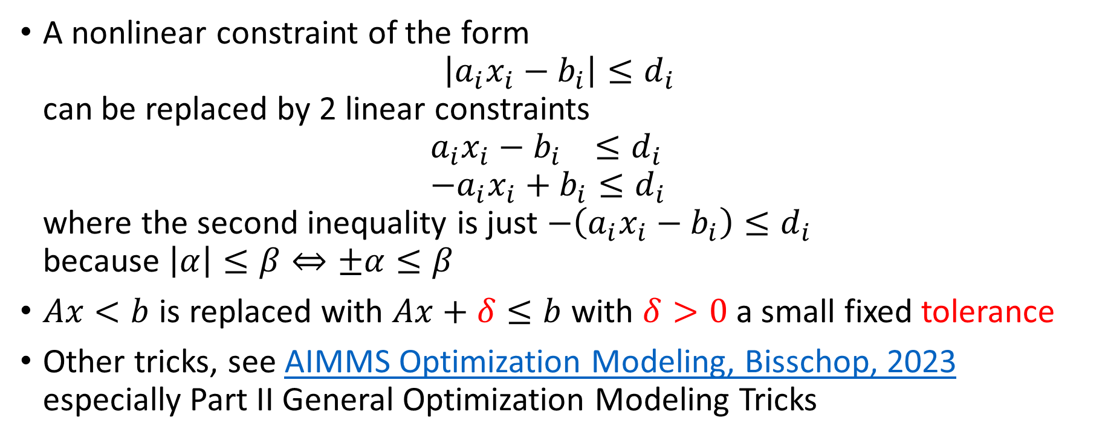
$$\max{z=c^{T}x subject to Ax=b, x≥0}$$
A nonlinear constraint of the form $\left|a_{i}x_{i}−b_{i}\right|≤d_{i}$ can be replaced by 2 linear constraints $a_{i}x_{i}−b_{i} ≤d_{i}$ $−a_{i}x_{i}+b_{i}≤d_{i}$ where the second inequality is just $−\left(a_{i}x_{i}−b_{i}\right)≤d_{i}$ because $\left|α\right|≤β⇔±α≤β$
$Ax<b$ is replaced with $Ax+δ≤b$ with $δ>0$ a small fixed tolerance
Other tricks, see AIMMS Optimization Modeling, Bisschop, 2023 especially Part II General Optimization Modeling Tricks

Slide 39
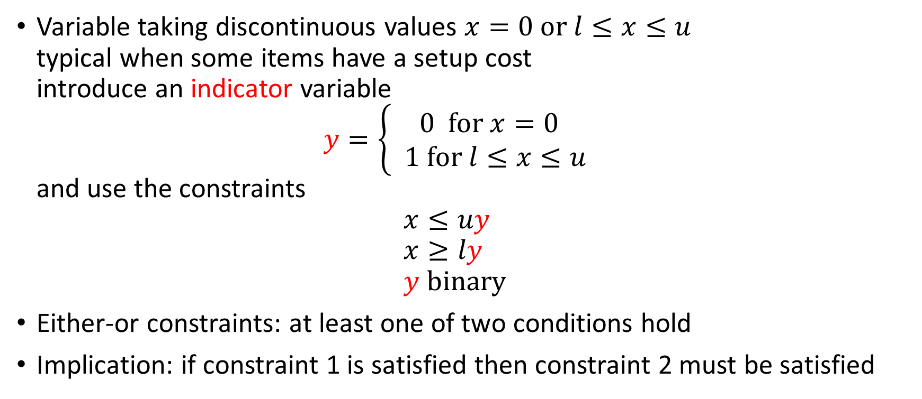
Integer programming tricks
Variable taking discontinuous values $x=0 or l≤x≤u$ typical when some items have a setup cost introduce an indicator variable $y=\left\{\begin{matrix}0 for x=0 \\ 1 for l≤x≤u\end{matrix}\right.$ and use the constraints $x≤uy$ $x≥ly$ $y binary$
Either-or constraints: at least one of two conditions hold
Implication: if constraint 1 is satisfied then constraint 2 must be satisfied

Slide 40
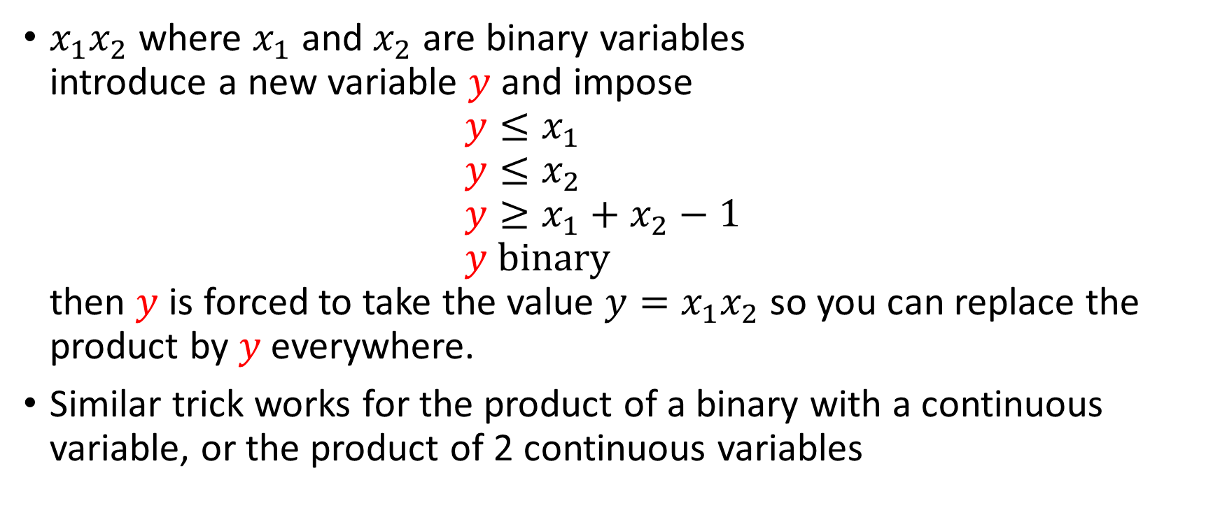
Integer programming tricks: product of variables
$x_{1}x_{2}$ where $x_{1}$ and $x_{2}$ are binary variables introduce a new variable $y$ and impose $y≤x_{1}$ $y≤x_{2}$ $y≥x_{1}+x_{2}−1$ $y binary$ then $y$ is forced to take the value $y=x_{1}x_{2}$ so you can replace the product by $y$everywhere.
Similar trick works for the product of a binary with a continuous variable, or the product of 2 continuous variables

Slide 41
Least-squares and “least absolute values”

Slide 42
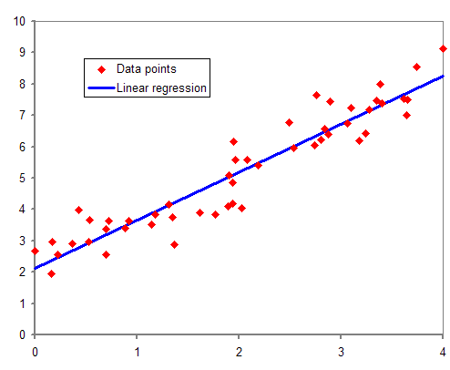
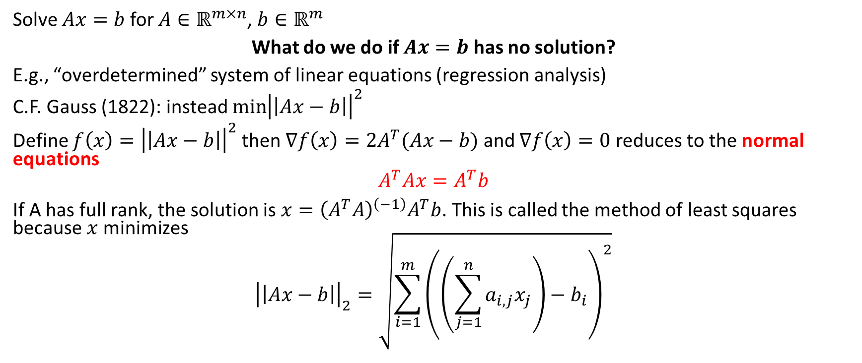
Classical least square (Gauss, 1822)
Solve $Ax=b$ for $A∈ℝ^{m×n}$, $b∈ℝ^{m}$
What do we do if $Ax=b$ has no solution?
E.g., “overdetermined” system of linear equations (regression analysis)
C.F. Gauss (1822): instead $\min{{\left|\left|Ax−b\right|\right|}^{2}}$
Define $f\left(x\right)={\left|\left|Ax−b\right|\right|}^{2}$ then $∇f\left(x\right)=2A^{T}(Ax−b)$ and $∇f\left(x\right)=0$ reduces to the normal equations
$$A^{T}Ax=A^{T}b$$
If A has full rank, the solution is $x={\left(A^{T}A\right)}^{\left(−1\right)}A^{T}b$. This is called the method of least squares because $x$ minimizes
$${\left|\left|Ax−b\right|\right|}_{2}=\sqrt{{\sum_{i=1}^{m}{\left(\left(\sum_{j=1}^{n}{a_{i,j}x_{j}}\right)−b_{i}\right)}}^{2}}$$
Amatulic at English Wikipedia (same as Anachronist on Wikimedia), Public domain, via Wikimedia Commons https://commons.wikimedia.org/wiki/File:Normdist_regression.png

Slide 43
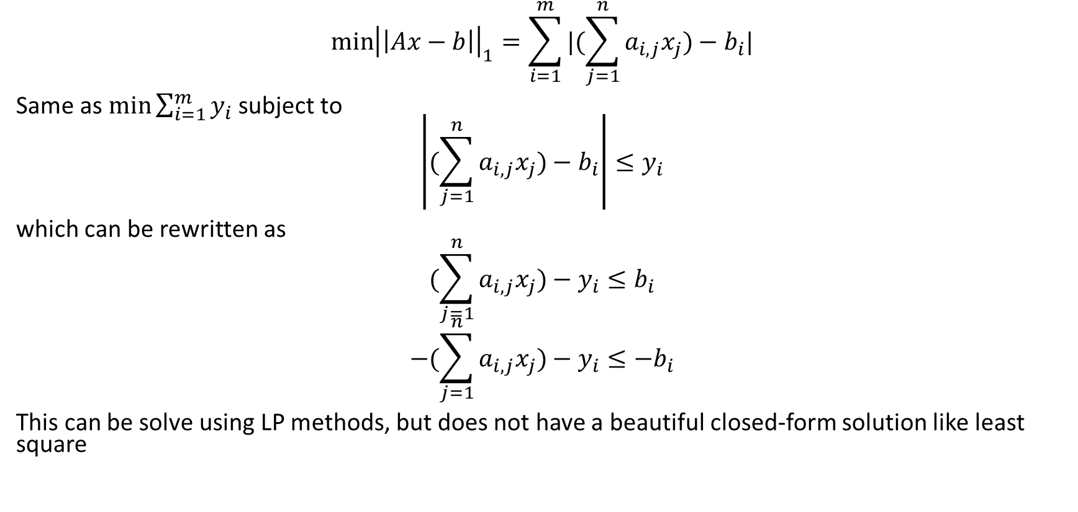
“least absolute values”
$$\min{{\left|\left|Ax−b\right|\right|}_{1}=\sum_{i=1}^{m}{|(\sum_{j=1}^{n}{a_{i,j}x_{j})−b_{i}|}}}$$
Same as $\min{\sum_{i=1}^{m}{y_{i}}}$ subject to
$$\left|(\sum_{j=1}^{n}{a_{i,j}x_{j})−b_{i}}\right|≤y_{i}$$
which can be rewritten as
$$(\sum_{j=1}^{n}{a_{i,j}x_{j})−y_{i}≤b_{i}} \\ −(\sum_{j=1}^{n}{a_{i,j}x_{j})−y_{i}≤{−b}_{i}}$$
This can be solve using LP methods, but does not have a beautiful closed-form solution like least square

Slide 44
The four possibilities for LP

Slide 45
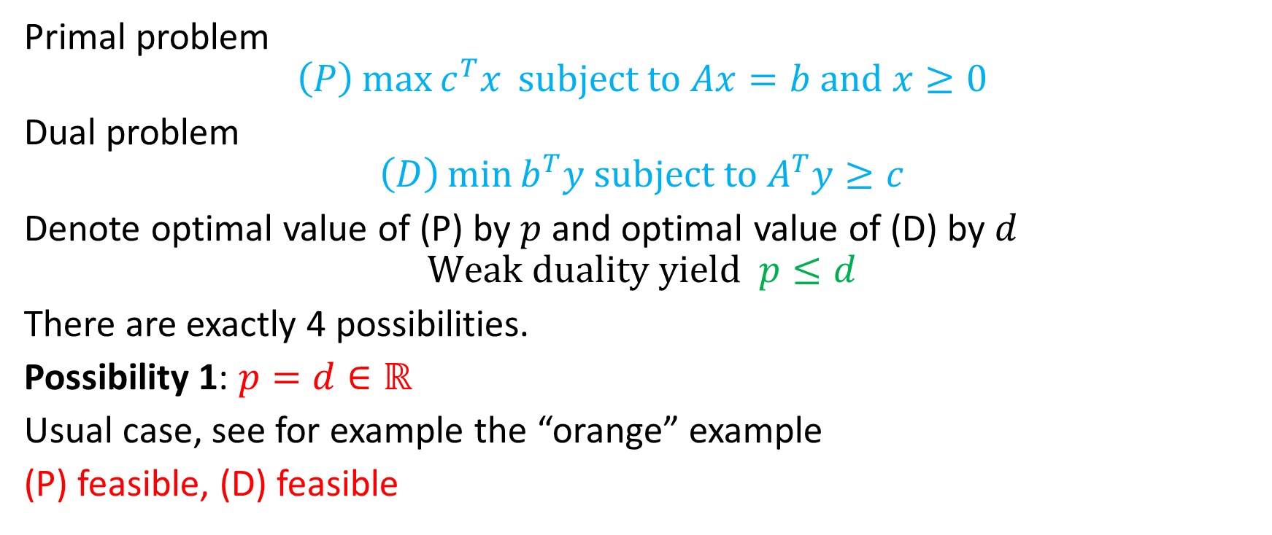

Possibility 1: $p=d∈ℝ$
Primal problem
$$\left(P\right)\max{c^{T}x }subject to Ax=b and x≥0$$
Dual problem
$$\left(D\right)\min{b^{T}y subject to A^{T}y≥c}$$
Denote optimal value of (P) by $p$ and optimal value of (D) by $d$
$$Weak duality yield p≤d$$
There are exactly 4 possibilities.
Possibility 1: $p=d∈ℝ$
Usual case, see for example the “orange” example
(P) feasible, (D) feasible

Slide 46
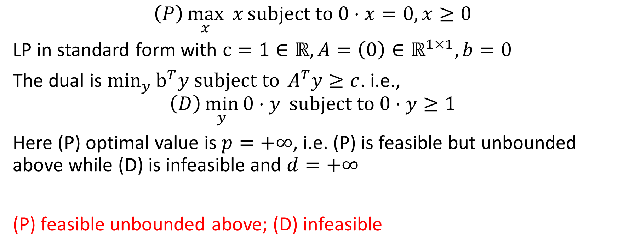

Possibility 2: $p=+∞, d=+∞$
$$\left(P\right)\max_{x}{x}subject to 0⋅x=0, x≥0$$
LP in standard form with $c=1∈ℝ, A=\left(0\right)∈ℝ^{1×1}, b=0$
The dual is $\min_{y}{b^{T}y subject to }A^{T}y≥c$. i.e.,
$$\left(D\right)\min_{y}{0⋅y} subject to 0⋅y≥1$$
Here (P) optimal value is $p=+∞$, i.e. (P) is feasible but unbounded above while (D) is infeasible and $d=+∞$
(P) feasible unbounded above; (D) infeasible

Slide 47
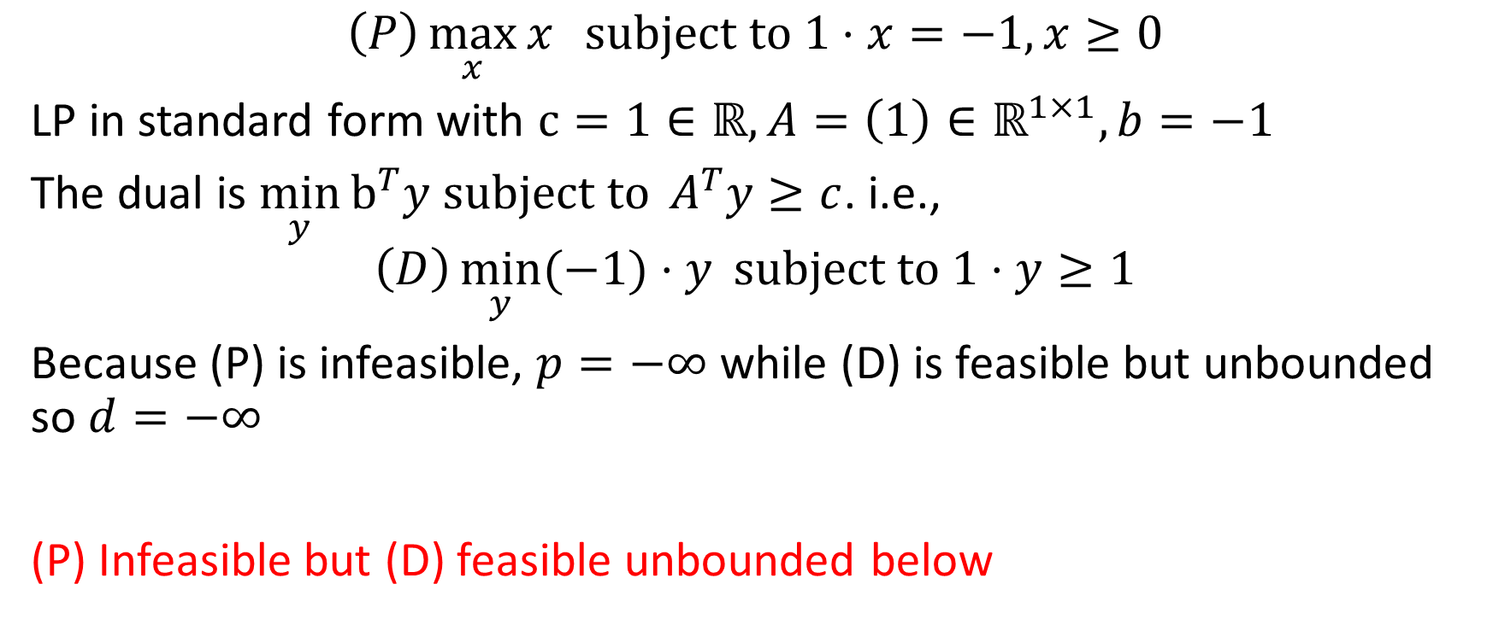

Possibility 3: $p=−∞, d=−∞$
$$\left(P\right)\max_{x}{x} subject to 1⋅x=−1, x≥0$$
LP in standard form with $c=1∈ℝ, A=\left(1\right)∈ℝ^{1×1}, b=−1$
The dual is $\min_{y}{b^{T}y subject to }A^{T}y≥c$. i.e.,
$$\left(D\right)\min_{y}{(−1)⋅y} subject to 1⋅y≥1$$
Because (P) is infeasible, $p=−∞$ while (D) is feasible but unbounded so $d=−∞$
(P) Infeasible but (D) feasible unbounded below

Slide 48
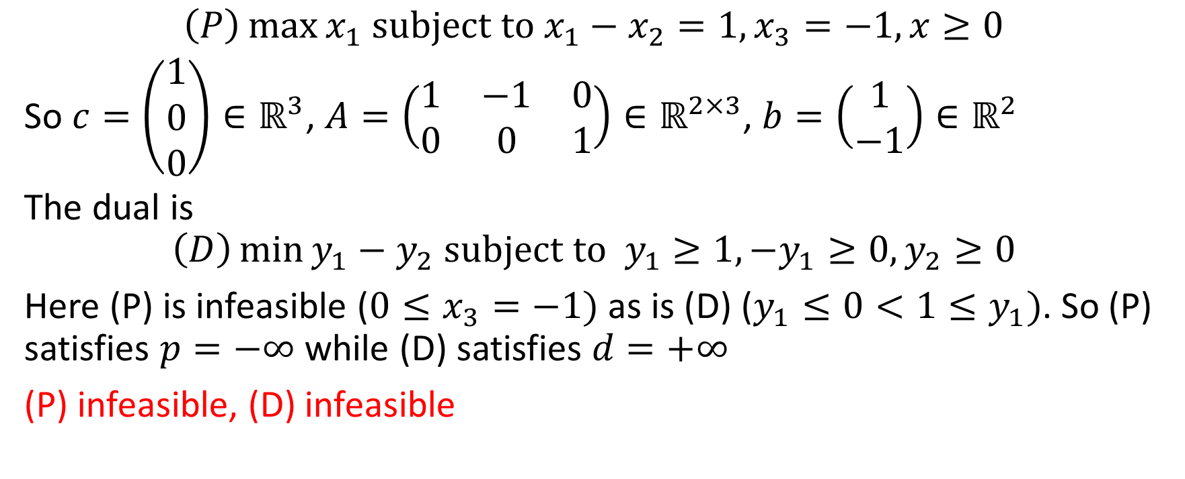

Possibility 4: $p=−∞, d=+∞$
$$\left(P\right)\max{x_{1} subject to x_{1}−x_{2}=1, x_{3}=−1, x≥0}$$
So $c=\left(\begin{matrix}1 \\ 0 \\ 0\end{matrix}\right)∈ℝ^{3}$, $A=\left(\begin{matrix}1 & −1 & 0 \\ 0 & 0 & 1\end{matrix}\right)∈ℝ^{2×3}$, $b=\left(\begin{matrix}1 \\ −1\end{matrix}\right)∈ℝ^{2}$
The dual is
$$\left(D\right)\min{y_{1}−y_{2} subject to y_{1}≥1, −y_{1}≥0, y_{2}≥0}$$
Here (P) is infeasible ($0≤x_{3}=−1)$ as is (D) ($y_{1}≤0<1≤y_{1})$. So (P) satisfies $p=−∞$ while (D) satisfies $d=+∞$
(P) infeasible, (D) infeasible

Slide 49
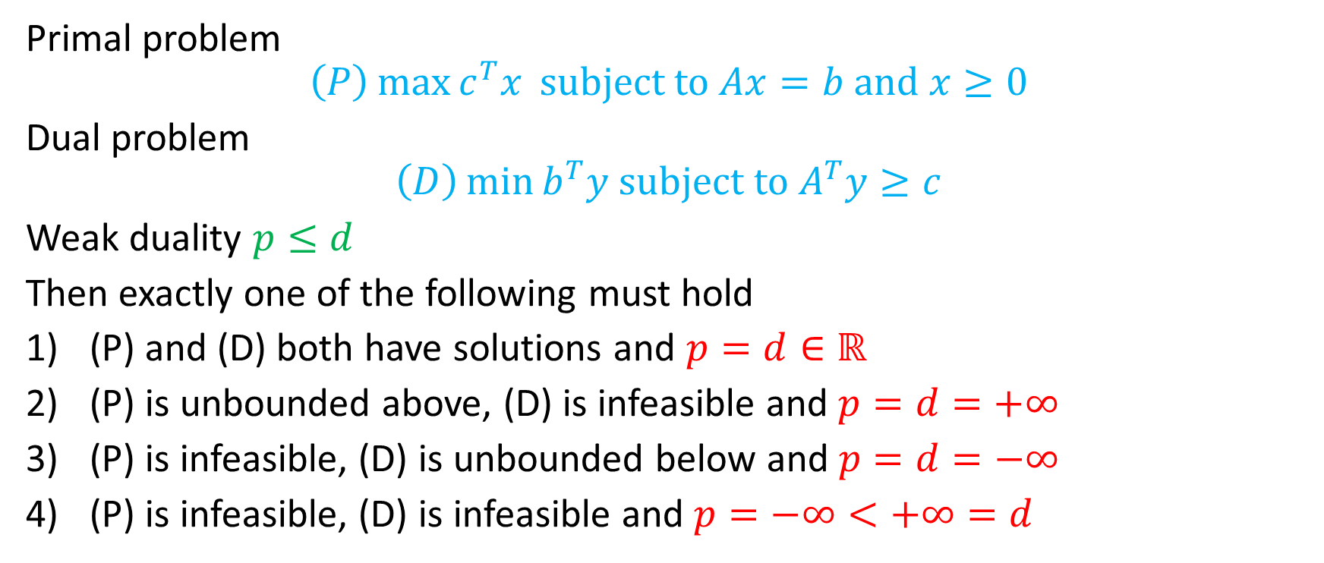
Summary (the four possibilities)
Primal problem
$$\left(P\right)\max{c^{T}x }subject to Ax=b and x≥0$$
Dual problem
$$\left(D\right)\min{b^{T}y subject to A^{T}y≥c}$$
Weak duality $p≤d$
Then exactly one of the following must hold
(P) and (D) both have solutions and $p=d∈ℝ$
(P) is unbounded above, (D) is infeasible and $p=d=+∞$
(P) is infeasible, (D) is unbounded below and $p=d=−∞$
(P) is infeasible, (D) is infeasible and $p=−∞<+∞=d$
Notes:
Strong duality holds in possibilities 1, 2, and 3. It does not hold for Possibility 4

Slide 50
Selected references
AIMMS Optimization Modeling, Bisschop, 2023 https://documentation.aimms.com/_downloads/AIMMS_modeling.pdf especially Part II General Optimization Modeling Tricks
Branch-and-bound example http://web.tecnico.ulisboa.pt/mcasquilho/compute/_linpro/TaylorB_module_c.pdf
AMPL stands for \a mathematical programming language". Developed by Robert Fourer, David Gay and Brian Kernighan, it is the most popular modeling language on the NEOS (network-enabled optimization system) server.
The AMPL book https://ampl.com/resources/the-ampl-book/
Try AMPL online: https://ampl.com/try-ampl/try-ampl-online/
NEOS Server: https://neos-server.org/neos/
George B. Dantzig and Mukund N. Thapa: Linear Programming I,II
Thomas S. Ferguson: Linear Programming, https://www.math.ucla.edu/~tom/LP.pdf
B. Guenin, J. K¨onemann, and L. Tun¸cel: A Gentle Introduction to Optimization
Frederick S. Hillier and Gerald J. Lieberman: Introduction to Operations Research
Wayne L. Winston: Operations Research
Wikipedia

